Slide 1
NACHCs Policy & Issues Forum 2024
Marriott Marquis, Washington, D.C.
Committee Meetings: February 10-11
Conference: February 12-15
Capitol Hill Day – Wednesday, February 14
California Delegation Meeting Hosted by CPCA Advocates
Tuesday, February 13 / 5:30 - 6:30 PM EST
Room: Salon Two
On site staff: Victor Christy (victor@cpcaadvocates.org)
CPCA Advocates Member Prep Webinar

Slide 2
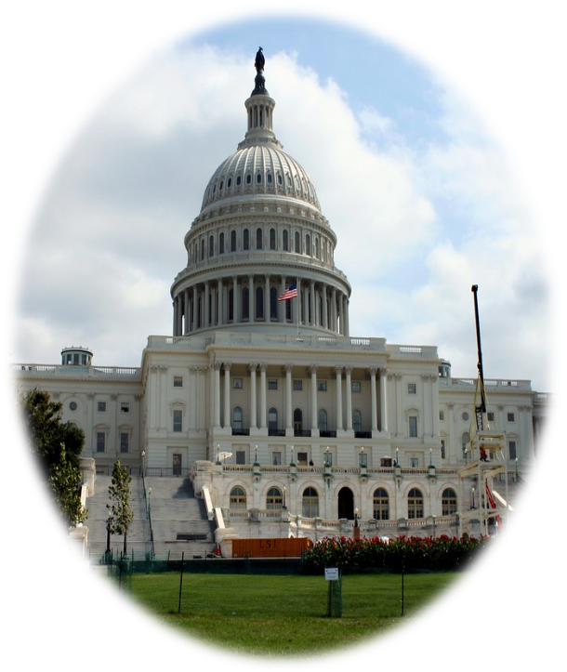
Agenda
Welcome
Political Landscape in D.C.
NACHC’s Policy Agenda
California Priorities
Congressional Hill Visits
Social Media
Q & A

Slide 3
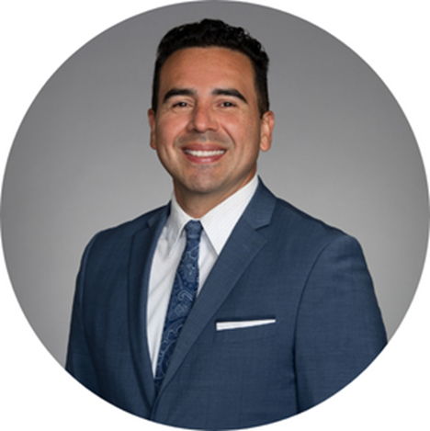
Welcoming Remarks
Dennis Cuevas-Romero
VP of Government Affairs
CPCA Advocates

Slide 4
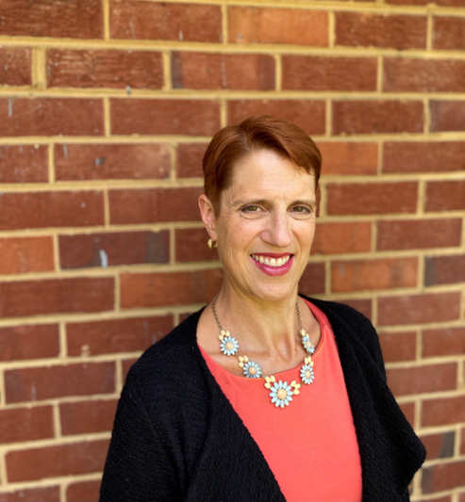
Political Landscape in D.C.
Angie Melton
Vice President
McAllister & Quinn

Slide 5
NACHC’s Policy Agenda
Health Center Funding
  Maximum mandatory funding in bipartisan agreement ; finalize FY2024 discretionary funding with targeted investments supporting primary care
Workforce
  Maximum funding in bipartisan agreement for NHSC & TCEGME; workforce innovation program
340B
  Bring long-term stability to the program and protect access for true safety-net providers
Telehealth
  Extend pandemic flexibilities relative to geographic restrictions, audio-only coverage and payment parity

Slide 6
NACHC P&I Materials
Main Issue Areas
Health Center Funding
Workforce
340B
Telehealth
Materials
Policy papers will be available on the Hill Day Resource Hub
California-specific one-pagers on Workforce and CA Behavioral Health Transformation efforts

Slide 7
Hill Visits – Best Practices
Coordinate with meeting attendees in advance. (Before you go to DC or at the CPCA Advocates State Delegation meeting)
Ensure meeting attendees know the meeting date, time, and place for the meeting. (Meet outside the office at least 10 min before)
Research the members you will be meeting with beforehand.
Stay on topic and focus on issues relevant to your health centers.
Tailor messaging and highlight constituent stories.
Be specific with the ASK and gain commitment!
If appropriate, ask members or staff members to take a picture.
Thank Members of Congress and their staff for their support and offer to provide additional follow-up information as needed.

Slide 8
Hill Visit Follow-Up
Have a follow up plan
Send a thank you note to the member or staffer.
Send electronic leave-behind packet and other information requested during the meeting via email.
Invite your members to visit a health center in their district.
Post on social media using the appropriate platform
Add a photo or two
Use the event hashtags
Tag the member, health center, and @CPCAadvocates
Thank the public official you met with on social media

Slide 9
Use Social Media at P&I
Use the appropriate social media platform.
  X (Twitter), Facebook, or Instagram
  Tag @CPCAAdvocates and @NACHC
Add a photo or two to your post.
Post about the event and why you are in D.C. (or virtual!)
Share why you are passionate about community health centers!
Bring awareness to a subject by using hashtags: #NACHCEvents #ValueCHCs #CHCWorkforce #340B
Share the content of others. Make sure to follow the hashtags to stay engaged.
Connect with an individual, legislator, or organization by tagging them in your posts.
Notes:
Reminder we have a list of social media handles on our website that are for reference by district!

Slide 10
Questions?

Slide 11
Contact Us
Policy Priorities
  Angie Melton - amelton@jm-aq.com
  Dennis Cuevas-Romero - dennis@cpcaadvocates.org
Logistics & On-site Contact
  Victor Christy - victor@cpcaadvocates.org
Materials
  Kelley Aldrich - kelley@cpcaadvocates.org
Social Media
  Taylor Beckwith - tbeckwith@cpcaadvocates.org

