Slide 1

Member Prep Webinar
April 11, 2024
Member Prep Webinar
2024 Annual Day at the Capitol, April 16
Presented by:
Joanne Preece and Lily Dorn, Government & External Affairs, CCALAC
jpreece@ccalac.org
ldorn@ccalac.org

Slide 2
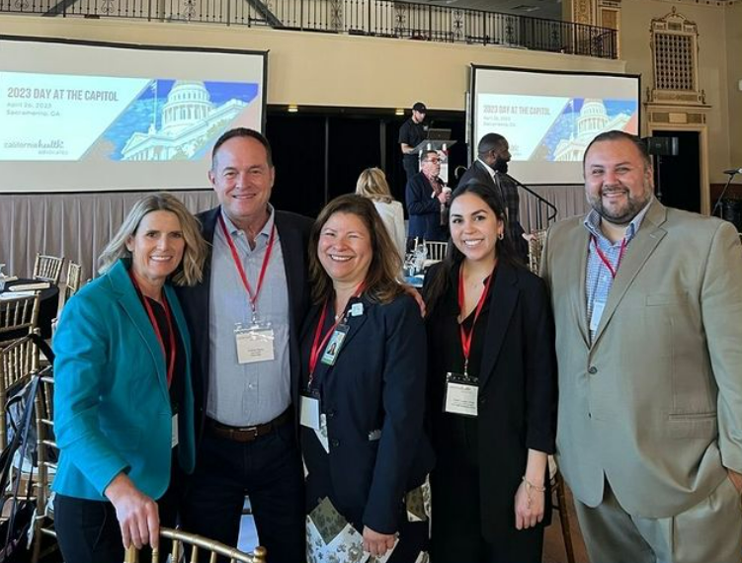
Agenda
Meeting Schedule
Materials
Health Center Priorities Checklist
Health Center Priorities Overview
Legislative Meeting Logistics
Social Media Advocacy

Slide 3
Meeting Schedule & Logistics

Slide 4
Schedule
The latest DAC schedule will be emailed late Thursday or Friday
  There's always changes, watch inbox for schedule updates!
  Updated versions of the schedule will be emailed and posted HERE (scroll down to advocacy events).
  NO outlook calendar invites for DAC meetings – follow the latest version of the schedule.
If you have sites in other counties, contact that consortia for those meetings.
Email Kaylee Peterson at kpeterson@ccalac.org with questions.

Slide 5
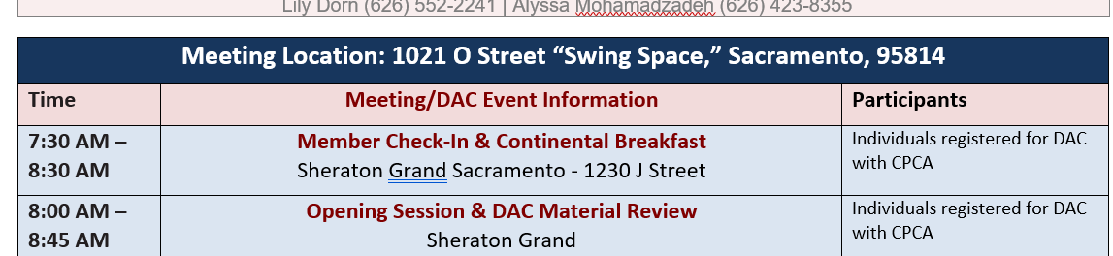
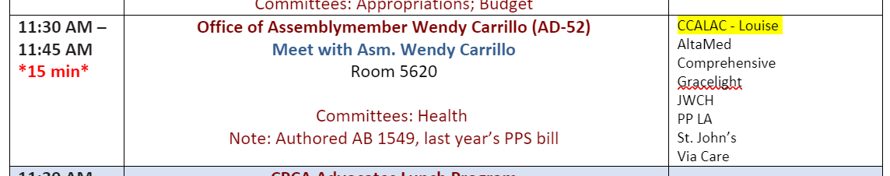
The Schedule

Slide 6
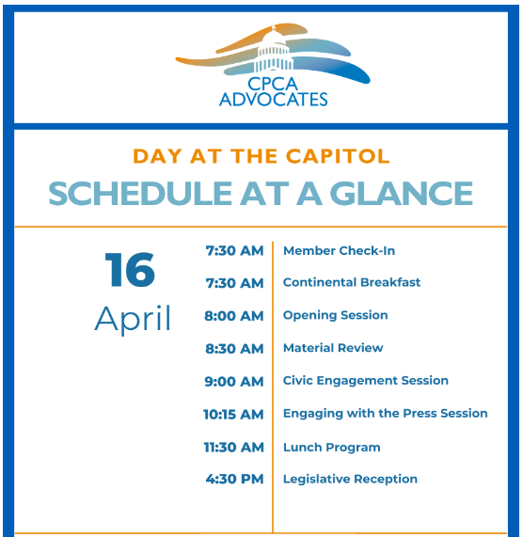
CPCA Advocates DAC events are at the Sheraton Grand Hotel at 1230 J Street. Allow 15-20 minutes to walk between the Sheraton and the Swing Space, plus time for security and elevators.

Slide 7
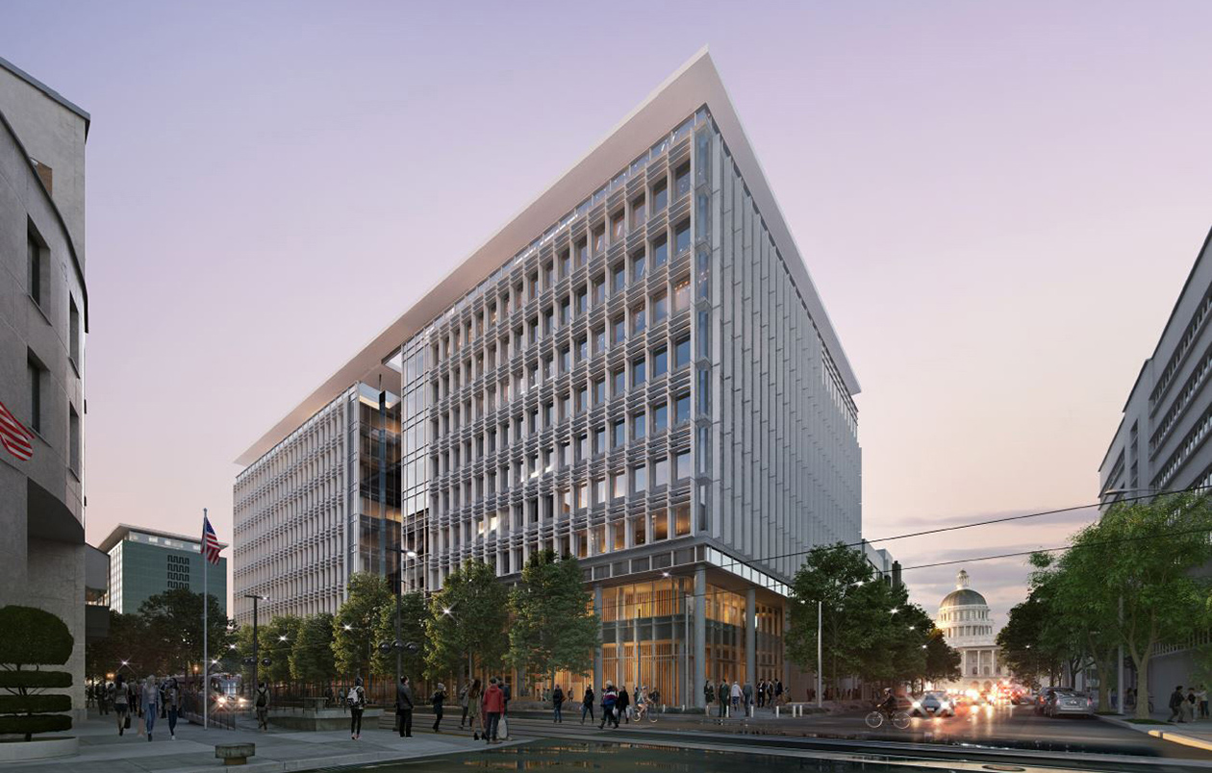
Where are the meetings?
The legislature is now in the Capitol Annex Swing Space located at 1021 O Street.

Slide 8
Directions & Planning
Capitol Annex Swing Space; 1021 O Street.
  Two blocks south of the capitol; Hyatt and CPCA are on the north side.
  From the front of the Hyatt facing the Capitol, you will walk around and past the right (West) side of the Capitol building
  Allow time to get through security and get your bearings if you've not been to this building before
Elevators can be slow – stairs are an option to travel between floors
  This also frees up elevator space for others
  Note, this building is 8 floors, the Capitol was only 5 or 6.
Comfortable shoes are recommended. Bring water and snacks if you have multiple meetings. There is a small cafeteria.

Slide 9
Meeting Timing
Meetings are only 15-20 minutes!
Be concise and mindful of time when speaking so everyone gets a chance to speak.
Please watch the clock! Meetings must end on time so people can get to their next meeting (if we are nearing 15-20 minutes, please keep additional comments short).
CCALAC and CPCA have spoken with many offices already and will follow-up with offices afterward.
If we don't cover every priority or every detail, it's OK.

Slide 10
Meeting Structure
Please meet in the hallway outside the office/room - offices have limited space and we want to connect as a group before we go in.
Meetings will have a CCALAC staff “Lead” to facilitate introductions and guide discussion.
Introductions - include where your sites are located and any special services you provide in the district.
Lead will facilitate a brief discussion on priorities and invite members to chime in on specific topics.
  Lead will prioritize discussing Assembly Bills with Assembly Offices and Senate Bills with Senate Offices, and in some offices, we know the staff and their backgrounds and will adjust accordingly – not every meeting will be identical.
  If the lead discusses a specific bill in more detail and spends less time on others or avoids certain priorities altogether, please follow our lead as we are tailoring to the specific office and trying to maximize our limited time with them.
  If an office sits on a committee (such as Health) scheduled to hear a priority bill soon, we will utilize the meeting to address our position/concerns and request the member's vote ahead of the hearing.

Slide 11
Who are we meeting with?
If the meeting is with the Assemblymember or Senator themselves, they may drive the conversation and we’ll follow their lead
We have bill authors in the LA delegation and will adjust accordingly when meeting with them or their staff (J. Carrillo & Smallwood-Cuevas)
If we are meeting with staff:
  They may be knowledgeable or interested in specific issues. If relevant we will follow their lead, this is an opportunity to build relationships by talking about what is of most interest to them.
  If we discover we are meeting with staff who are newer or unfamiliar with health centers, try to keep the conversation high level.
  Some staff may be very unfamiliar with PPS, OSHPD3 and MCO tax details; we will read the room and adjust as needed. The goal is to put our issues on their radar, not to overwhelm.

Slide 12
Materials

Slide 13
Materials
CCALAC will provide materials to offices ahead of time so they know what we plan to discuss and have background on our priority issues.
Many offices do not want paper and will only accept electronic materials.
The CCALAC Staff lead will have hard copies of a few documents (profiles and checklist) for reference and to guide the discussion.
CCALAC’s Talking Points will align with our Checklist.
TPs, schedule and materials will be emailed late Thursday or Friday.
All materials (except talking points) will be posted on CCALAC’s Advocacy Resources webpage.
Members are encouraged to print what you need ahead of time. Hard copies will not be provided.

Slide 14
Materials
CCALAC will provide to offices:
County Profile
District Profile
CHC Priorities Checklist
AB 2303 Fact Sheet (& support letter)
AB 1067 Fact Sheet
SB 1382 Fact Sheet
CPCA Budget Letter
CCALAC Coverage and Access Report & Infographic
CCALAC Workforce Report & Infographic
CCALAC will have hard copies at meetings (to support facilitation):
County Profile
District Profile
Priorities Checklist
Additional member materials:
Talking Points
Meeting Schedule

Slide 15
DAC Priorities

Slide 16
Checklist for Healthy Communities
Ensure Health Centers Can Sustainably Implement SB 525 Wage Mandates
  Direct the state to seek federal approval of a mechanism called an Alternative Payment Methodology to create an add-on to FQHC Medi-Cal reimbursement rates to account for the increased costs by supporting AB 2303 (J. Carrillo).
  Support the corresponding budget ask to provide the resources for AB 2303's add-on payments.
Address Health Care Workforce Shortages in Medically Underserved Areas: Expedite the provider licensing process for applicants who plan to serve a Medically Underserved Area (MUA) and/or Population (MUP) by supporting SB 1067 (Smallwood-Cuevas).
Remove Barriers to Expanding Access to Care: Facilitate new sites, expansion, and renovation by better aligning CHC building standards with the care provided in the CHC setting by supporting SB 1382 (Glazer).
Safeguard Funding for CHCs in MCO Tax Spending Plan: Ensure the provider network that serves 1 in 3 Medi-Cal members is included in MCO Tax spending plan, by preserving $50M dedicated to CHC services and supports and ensuring Targeted Rate Increases include FQHCs and are not subject to reconciliation.

Slide 17
AB 2303 (J. Carrillo)
Under SB 525 (Chapter 890, 2023) the minimum wage at health centers will increase over the next several years to $25/hour by June 2027.
While health centers support higher wages, they can’t raise prices to cover increased staffing costs, and most of their revenue comes from Medi-Cal (>70-80% of patients have Medi-Cal).
The FQHC Medi-Cal PPS reimbursement structure does not allow for rates to be adjusted in response to new wage mandates or changes in labor costs.
Current law only allows an FQHC to submit a request to the state for a rate reevaluation under nine strict circumstances – the nine ‘triggering events’ do not include state-mandated wage increases.
  Most triggering events are related to adding or deleting services. Even when a trigger exists, requesting a rate adjustment is a lengthy, staff-intensive multi-year undertaking (that often involves significant spending on consultants).
  A rate increase is not assured and a health center must take on the new costs associated with the "triggering event' with no guarantee they will eventually be recouped while the process plays out with the state.
For FQHCs to implement SB 525, they need a Medi-Cal reimbursement mechanism to adjust or add-on to existing rates and funding to support the increased costs of the wage increases.

Slide 18
AB 2303 & Budget Request
AB 2303 (J. Carrillo) would direct the state to seek the necessary federal approval (CMS) to authorize an Alternative Payment Methodology (APM) to cover the new costs associated with a state-mandated wage increase.
  An APM is a mechanism allowable under federal rules that can direct funding to FQHCs in addition to their PPS rates; the FQHC vaccine administration fee implemented during COVID was constructed as an APM.
  Status: Set for hearing in Assembly Health Committee on April 23.
Budget Request: CPCA Advocates is requesting a general fund investment to support the minimum wage increases and corresponding salary adjustments for employees at FQHCs, via AB 2303's add-on mechanism.

Slide 19
AB 2303: Ask & Discussion
Ask: Please support AB 2303 when it comes before you in Committee or on the floor.
Ask: Please support this budget request to support health center workers and the sustainability of health centers in your district.
Members Discuss
Financial impact of SB 525 on your organization.
At a very high level, how existing rate adjustment process is insufficient to address SB 525 wage increases.

Slide 20
SB 1067 (Smallwood-Cuevas)
SB 1067 seeks to create an expedited licensure application process for healthcare providers who demonstrate they intend to practice in a medically underserved area (MUA) or serve a medically underserved population (MUP).
Licensing delays undermine quality patient care, timely access to care, and further compounds the crisis-level healthcare workforce shortage in California.
The state’s healing arts boards – which license dentists, nurses, and other providers in California – have prolonged backlogs for processing applications for licensure, often preventing a provider from joining the workforce in a timely and efficient manner.
SB 1067 leverages an existing model in which the Medical Board of CA grants priority review status of license applications for physicians and surgeons who demonstrate they intend to practice in a MUA or serve a MUP. (BPC § 2092)
Status: Passed Senate Business, Professions and Economic Development on April 8. Referred to Senate Appropriations.

Slide 21
SB 1067: Ask & Discussion
Ask: Please support SB 1067 when it comes before you in Committee or on the floor.
Members Discuss
Share a specific story that highlights how prolonged delays impact hiring and onboarding.
Share what MUAs and MUPs your organization serves in the district.

Slide 22
SB 1382 (Glazer)
SB 1382 would modernize licensing and building standard requirements for community health centers while continuing to provide necessary patient protection.
Under current law, CHC building standards are tethered to those of hospital outpatient clinics.
  This is a problem because in the CHC setting only outpatient services are provided, while hospital clinics are allowed to provide up to 25 percent of their care as inpatient services.
  Thus, the standards for CHCs reflect the higher acuity of inpatient services at hospital clinics.
This existing law is preventing the state from modifying CHC building standards to reflect the outpatient care provided in the CHC setting.
This bill would untether CHCs from hospital clinics and stipulate that CHC building standards are no more restrictive than those of county outpatient clinics – a more appropriate and comparable setting.
Status: Set for hearing in Senate Health Committee on April 24.

Slide 23
SB 1382: Ask & Discussion
Ask: Support SB 1382 when it comes before you in Committee or on the floor.
Members Discuss
Has/is your organization delaying expansion or renovation plans because of current building standards?
Would you open new sites or expand hours if OSHPD3 wasn’t a barrier?

Slide 24
MCO Tax Spending Plan
The Managed Care Organization (MCO) Tax is crucial to address chronic underfunding of Medi-Cal and provides much needed new revenue.
The January Budget preserves $50 million in MCO Tax revenues dedicated to services and supports for CHCs. Health centers appreciate DHCS' proposal to combine this funding with the SPP for non-hospital 340B clinics and transition disbursement of the funding into a managed care directed payment program.
The MCO tax spending plan includes Targeted Rate Increases (TRI) in 2024 and 2025 intended to promote provider participation in the Medi-Cal program. As TRI is being implemented for 2024 and as proposed for 2025, health centers – which provide care to 1 in 3 Medi-Cal beneficiaries – are not included and will see no benefit from the increased rates.
Due to the FQHC reimbursement structure and annual reconciliation process any TRI funds that flow to health centers would eventually be reconciled back to the state.
Health centers urge the legislature to preserve the dedicated funding for CHCs in the MCO tax spending plan and protect TRI funding from the FQHC reconciliation process.

Slide 25
DAC Social Media Advocacy

Slide 26
Best Practices
Take photos and post on Instagram, Facebook and/or Twitter (X)!
At the end of your legislative meeting, ask the legislator or staff if you could take a group photo. Ask for permission to post on your social media account, and ask if they can repost, or also post the photo.
Bring awareness to DAC and the legislative priorities of CHCs.
Use hashtags: #DAC2024 #ValueCHCs #CHCAdvocacy.
Tag @CPCAAdvocates and @CCALAC.
Don't forget to tag your legislators! Click here (and scroll down) to access the social media handles for LA's Assemblymembers and Senators.

Slide 27
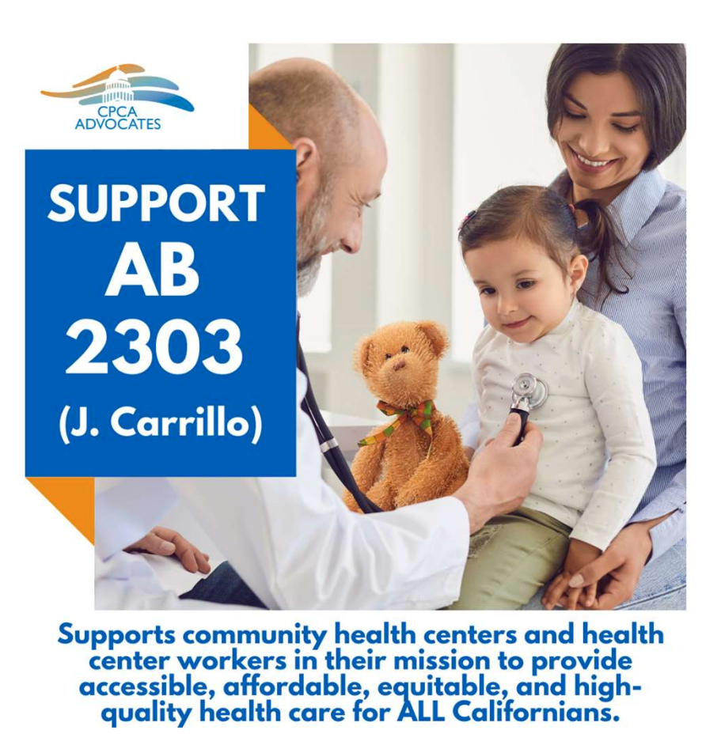
Capitol Power Hour!
Participate in CPCA's "Capitol Power Hour" between 12:00-1:00pm PT.
  Throughout the hour, uplift the importance of health centers' priority legislation.
  Access CPCA's premade graphics here.

Slide 28
Photo Ideas
Hashtags: #DAC2024 #ValueCHCs #CHCAdvocacy
Tag: @CPCAAdv on Instagram & Twitter
Take a photo or selfie…
In front of the State Capitol
In the new Swing Space
In front of your legislator’s office
If the legislator/staffer agrees, at the end of your legislative visit
With your colleagues/team
With your RAC/Consortia members
With a CPCA staff member
With CPCA CEO Francisco Silva
Attending educational sessions
During the lunch program
At The Mix during the legislative reception

Slide 29
Questions?
See you in Sacramento!
Current Forecast for DAC: Sunny, Low: 48, High 73

