Slide 1

CCALAC’s Cybersecurity Toolkit
Member Driven. Patient Focused.
Presented by:
Candice Rowland, Manager of Health Information Technology and Cybersecurity Programs, CCALAC

Slide 2
Table of Contents
Member Driven. Patient Focused.
Cybersecurity Toolkit
Security and IT Vendors
Security Policies
Cybersecurity Templates
Compliance and Regulations
Resources
Other Toolkits and Guides
Security Frameworks
Introduction to Toolkit

Slide 3

Introduction to Cybersecurity Toolkit
Member Driven. Patient Focused.
Table of Contents
Includes the objectives of the cybersecurity toolkit, details regarding hyperlinks within the toolkit, and a brief overview of the cybersecurity landscape.

Slide 4
Member Driven. Patient Focused.
Objectives of the Toolkit
Learn about the security and IT vendors/tools utilized by some of the FQHCs in LA County, including general satisfaction scores.
Discover cybersecurity templates, frameworks, and policies organizations may want to consider implementing in order to improve their cybersecurity posture.
Find resources and other toolkits, including those specifically designed for healthcare cybersecurity, to help guide your organization in building out a robust cybersecurity program.
The toolkit includes resources that were developed by CCALAC and other reputable organizations who are experts in cybersecurity. Each organization was cited appropriately, and all documents are available online or at ccalac.org.

Slide 5
Member Driven. Patient Focused.
Guide to Toolkit Presentation
On each slide, the CCALAC logo on the top left is a hyperlink to go to the Table of Contents slide.
There is also a Table of Contents hyperlink on the top right of the title slides for each section.
Additional hyperlinks are provided on some slides in order to access that resource online.
Many of the provided resources are also available on the Cybersecurity section of our website at ccalac.org.

Slide 6
Member Driven. Patient Focused.
Cybersecurity Landscape
From January to August 2023, 327 data breaches had been reported to the Department of Health and Human Services (HHS) Office for Civil Rights, which affected over 40 million patients according to Becker’s Hospital Review. This is an increase of over 104% than the same point in 2022.
Many factors have contributed to these continual and drastic increases in healthcare breaches year-over-year. Most patient records are now accessible online, providing easier access to bad actors than ever before.

Slide 7
Member Driven. Patient Focused.
Cybersecurity Landscape
The COVID pandemic saw an extreme increase in phishing campaigns as people scrambled to learn the latest information on how to protect themselves from the virus. A large number of companies switched to remote work, greatly increasing the exposure to their networks.
Remote patient monitoring tools and other medical devices, which often are less secure and not easy to update, also saw a dramatic increase.

Slide 8
Member Driven. Patient Focused.
Cybersecurity Landscape
FQHCs are especially vulnerable as many do not have a dedicated cybersecurity budget and some don't even have cybersecurity included within their IT budgets at a time where cybersecurity budgets should be increasing.

Slide 9

Security and IT Vendors
Member Driven. Patient Focused.
Table of Contents
Includes a list of security and IT vendors and tools used amongst CCALAC members and that offer distinct services to empower organizations to strengthen their defenses against cyber threats.

Slide 10
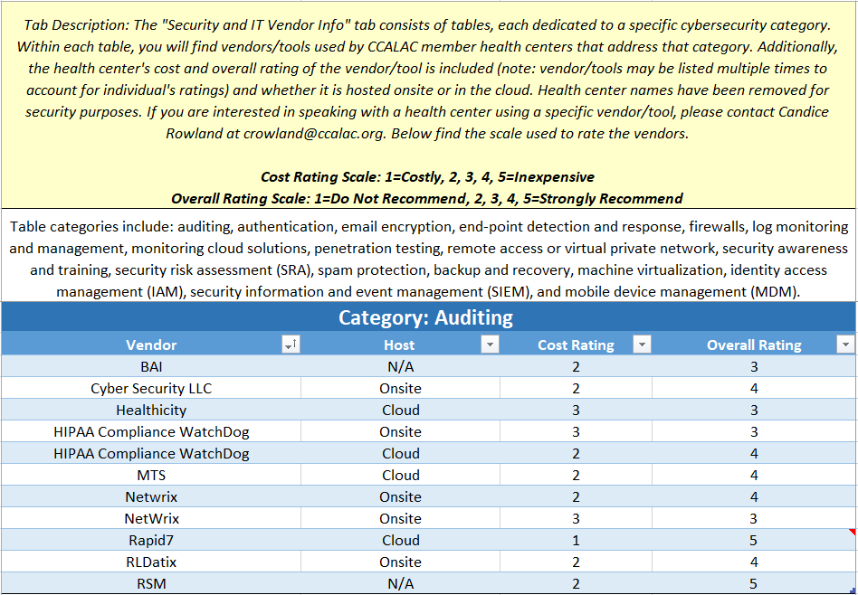
Member Driven. Patient Focused.
CSTK | Security IT and Vendors
Security IT and Vendors This tab consists of tables, each dedicated to a specific category of cybersecurity tool. Within each table, you will find tools/vendors used by CCALAC member health centers and whether the tool is hosted onsite or in the cloud. Additionally, you will find the clinic's cost and overall rating of the vendor. Health center names have been removed for security purposes. If you are interested in speaking with a health center using a specific vendor/tool, please contact Candice Rowland at crowland@ccalac.org. | Table categories include: auditing, authentication, email encryption, end-point detection and response, firewalls, log monitoring and management, monitoring cloud solutions, penetration testing, remote access or virtual private network, security awareness and training, security risk assessment (SRA), spam protection, backup and recovery, machine virtualization, identity access management (IAM), security information and event management (SIEM), and mobile device management (MDM).

Slide 11
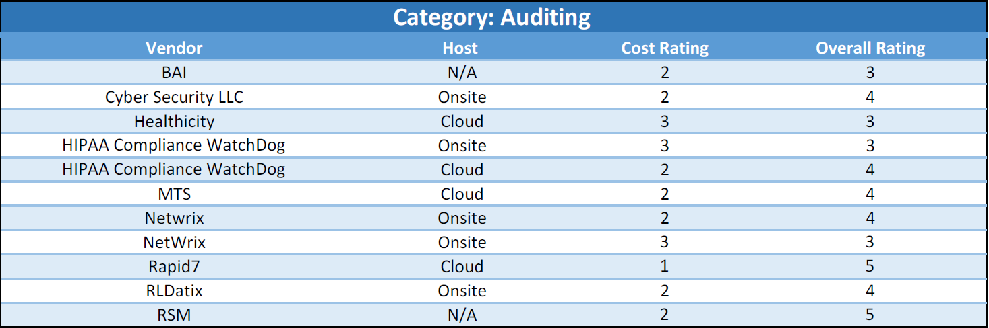
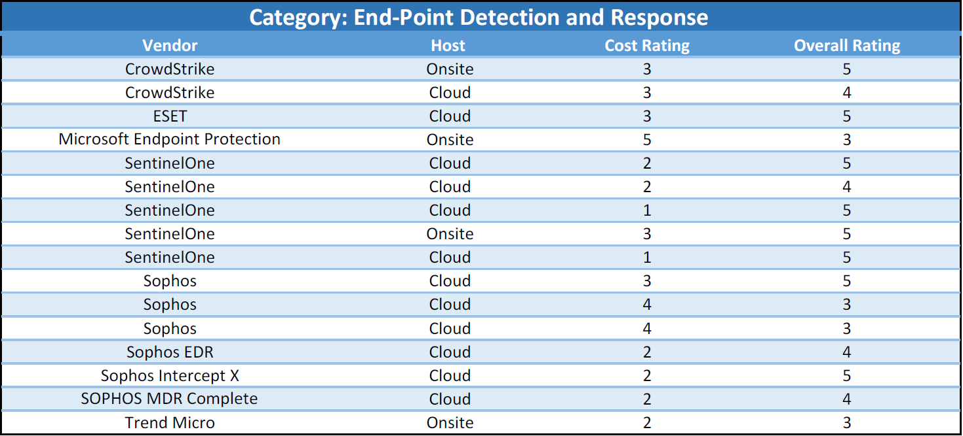
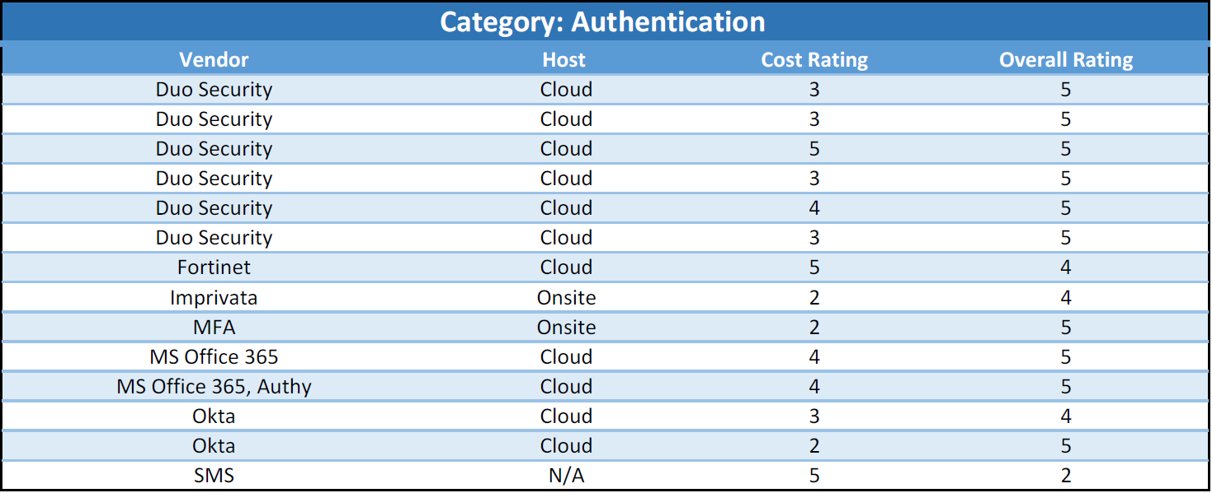
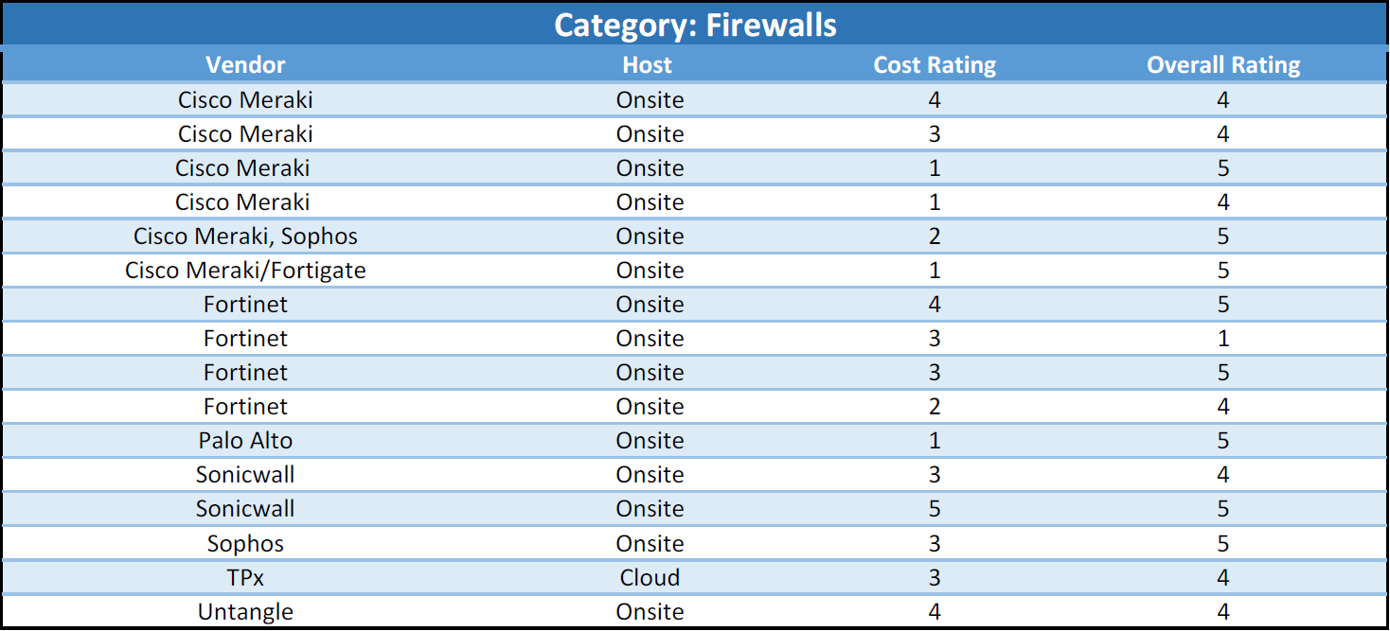
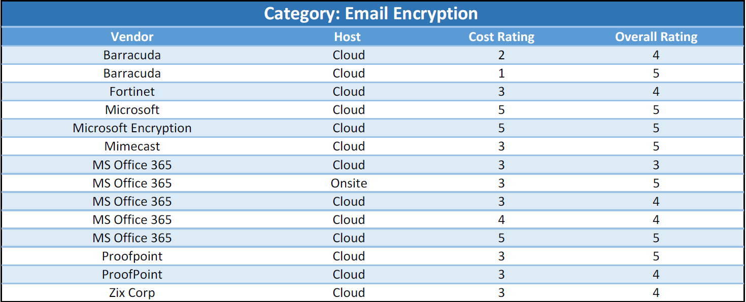
Member Driven. Patient Focused.

Slide 12
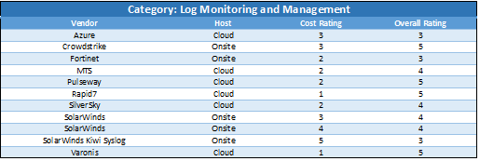
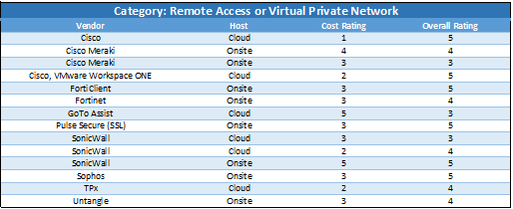
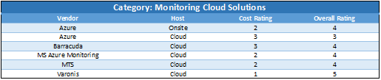
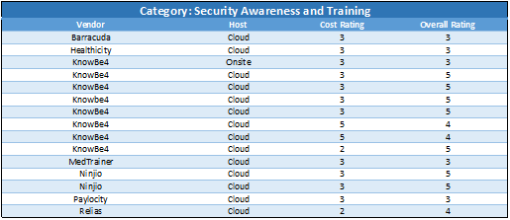
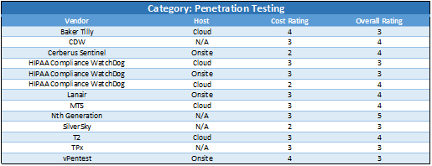
Member Driven. Patient Focused.

Slide 13
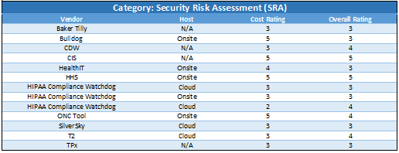
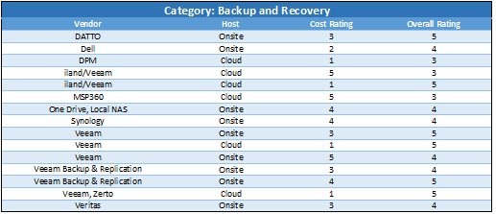
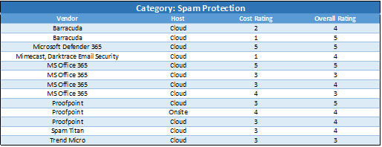
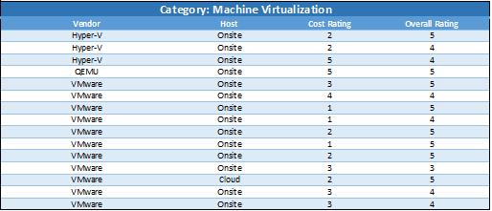
Member Driven. Patient Focused.

Slide 14
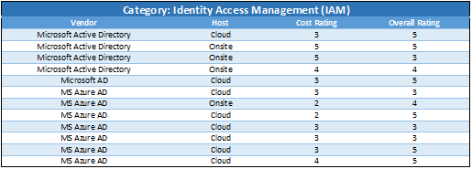
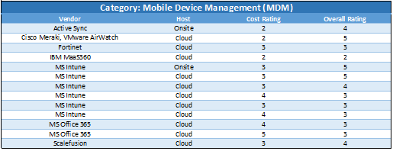
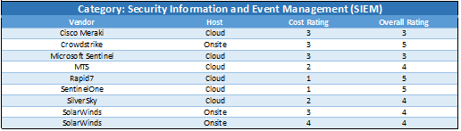
Member Driven. Patient Focused.

Slide 15
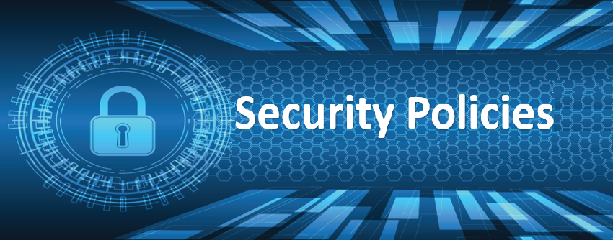
Security Policies
Member Driven. Patient Focused.
Table of Contents
Includes a checklist of security policies, along with brief descriptions, that health centers may want to consider implementing to establish a proactive and resilient cybersecurity environment.

Slide 16
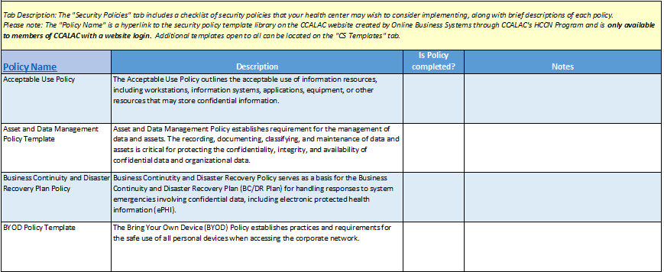
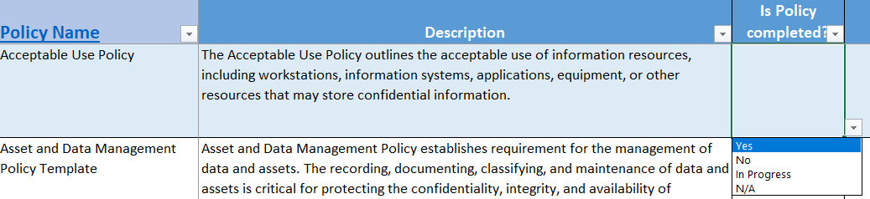
Member Driven. Patient Focused.
CSTK | Security Policies
Security Policies This tab provides a checklist for several security policies that should be considered for implementation within an organization to maintain cybersecurity. Security policies provide a roadmap for an organization's cyber security efforts, helping to create a proactive culture of security, reduce vulnerabilities, and protect sensitive information and assets. A dropdown list is available for the column “Is Policy Completed?” Policies developed by: Online Business Systems

Slide 17
Member Driven. Patient Focused.
Security Policy/Procedure | Description
Acceptable Use Policy | The Acceptable Use Policy outlines the acceptable use of information resources, including workstations, information systems, applications, equipment, or other resources that may store confidential information.
Asset and Data Management Policy Template | Asset and Data Management Policy establishes requirement for the management of data and assets. The recording, documenting, classifying, and maintenance of data and assets is critical for protecting the confidentiality, integrity, and availability of confidential data and organizational data.
Business Continuity and Disaster Recovery Plan Policy | Business Continuity and Disaster Recovery Policy serves as a basis for the Business Continuity and Disaster Recovery Plan (BC/DR Plan) for handling responses to system emergencies involving confidential data, including electronic protected health information (ePHI).
BYOD Policy Template | The Bring Your Own Device (BYOD) Policy establishes practices and requirements for the safe use of all personal devices when accessing the corporate network.
Device and Media Controls Policy Template | The Device and Media Controls Policy governs the receipt and removal of hardware and electronic media that contain confidential data, including ePHI, in and out of organizational facilities and movement within facilities.

Slide 18
Member Driven. Patient Focused.
Security Policy/Procedure | Description
Facility Access Policy Template | The Facility Access Policy details how physical access to the organization’s facilities and applications is controlled, while ensuring properly authorized access is allowed.
Identity Management and Access Control Policy Template | The Identity Management and Access Control Policy governs Workforce Member access to information resources, including systems, workstations, and confidential data.
Information Security Program Management Policy Template | The Information Security Program Policy establishes an organizational wide information system security program and sets forth governance and other general program requirements.
Logging and Monitoring Policy Template | This Policy governs logging which will take place on the network, system, and application level to monitor login, access, activity, and movement of data.
Remote Access Policy Template | Remote Work and Access Policy sets forth requirements and acceptable criteria for remote access to the organization’s network, information systems, and assets.
Security Awareness and Training Policy Template | This Policy outlines scope, responsibilities, processes associated with security awareness training, privacy, and cyber security awareness and training.

Slide 19
Member Driven. Patient Focused.
Security Policy/Procedure | Description
Security Incident Response Policy Template | This Policy outlines the scope, responsibilities, and guidelines for responding to security incidents within the organization.
Security Risk Management Policy Template | This Policy outlines the scope, responsibilities, and processes associated with risk identification, assessment and analysis, mitigation, acceptance, and continuous monitoring.
Third-Party Management Policy Template | This policy outlines the requirements for the management of third-parties and Business Associates (BAs) who have access to and handle confidential data, including ePHI, and information resources.
Transmission and Storage Policy Template | The Transmission and Storage Policy establishes guidelines for Workforce Members to ensure the secure transmission and storage of confidential data, including electronic protected health information (ePHI).
Workforce Security Policy Template | Workforce Security ensures that all members of the organization’s workforce have appropriate access to confidential data, including ePHI, to support job functions, while establishing policy to prevent inappropriate access to data.

Slide 20
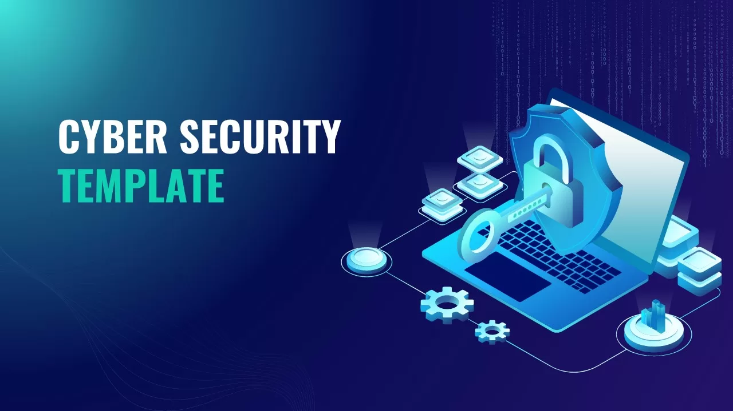
Cybersecurity Templates
Member Driven. Patient Focused.
Table of Contents
Includes a list of cybersecurity templates that adhere to industry best practices
when developing and implementing various cybersecurity measures.

Slide 21
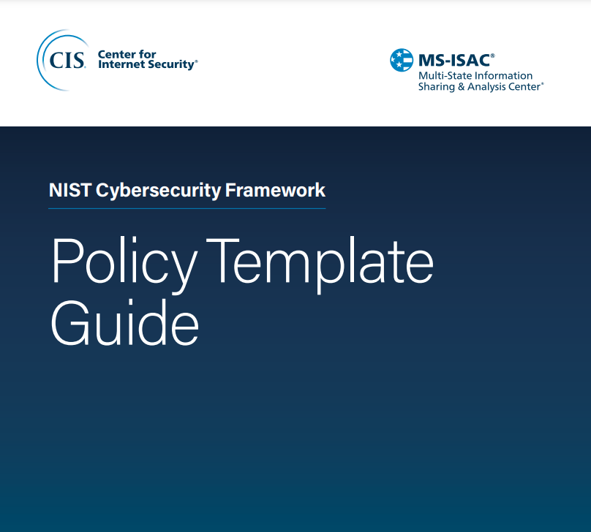
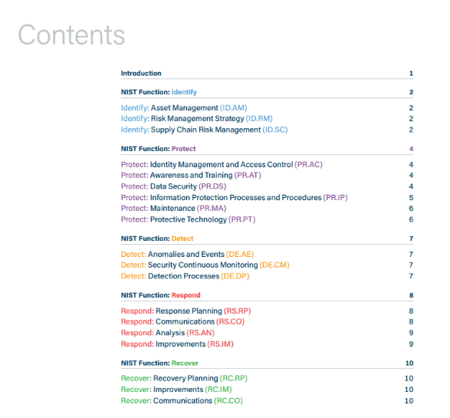
Member Driven. Patient Focused.
CSTK | Cybersecurity Templates
CS Template: NIST CSF Policy Template Guide (PLEASE NOTE CLICKING ON THE LINK ABOVE WILL AUTOMATICALLY DOWNLOAD A PDF COPY) Description: These templates were created as a resource to assist with the application and advancement of cybersecurity policies in accordance with the NIST (National Institute of Standards and Technology) Cybersecurity Framework. They can be customized and used as an outline of an organizational policy, with additional details to be added by the end user. Developed by: Multi-State Information Sharing & Analysis Center (MS-ISAC) and Center for Internet Security (CIS)

Slide 22
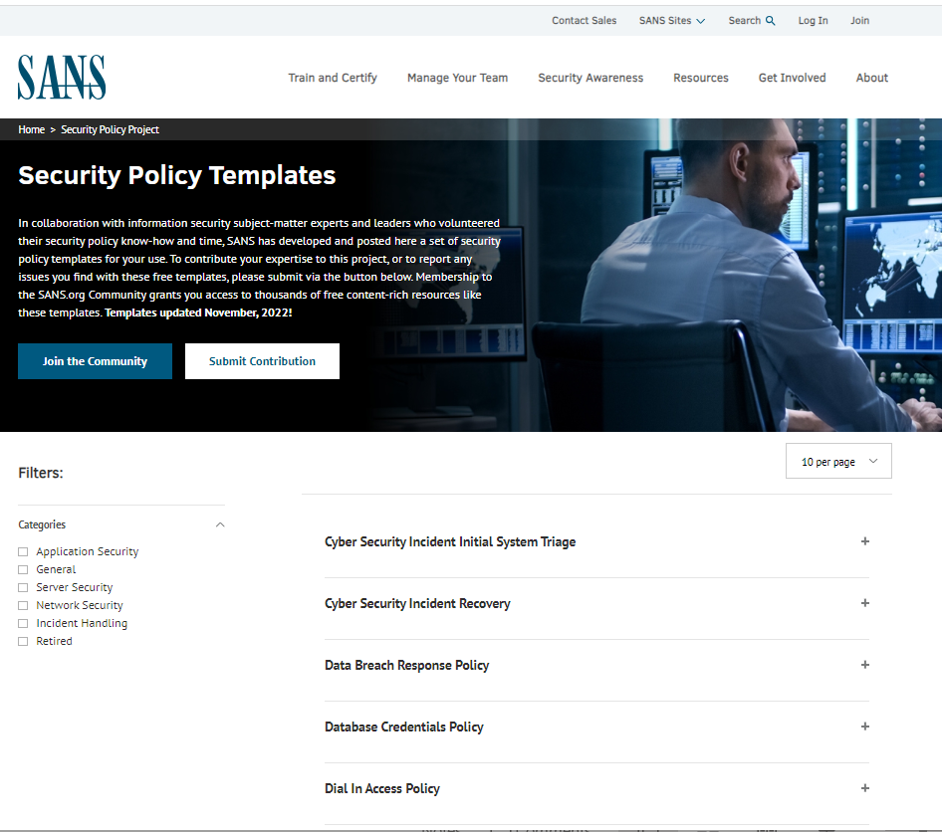
Member Driven. Patient Focused.
CSTK | Cybersecurity Templates
CS Template: Information Security Policy Templates | SANS Institute Description: In collaboration with information security subject-matter experts and leaders who volunteered their security policy know-how and time, SANS (SysAdmin, Audit, Network, and Security) has developed and posted a set of security policy templates for anyone to use. Developed by: SANS

Slide 23
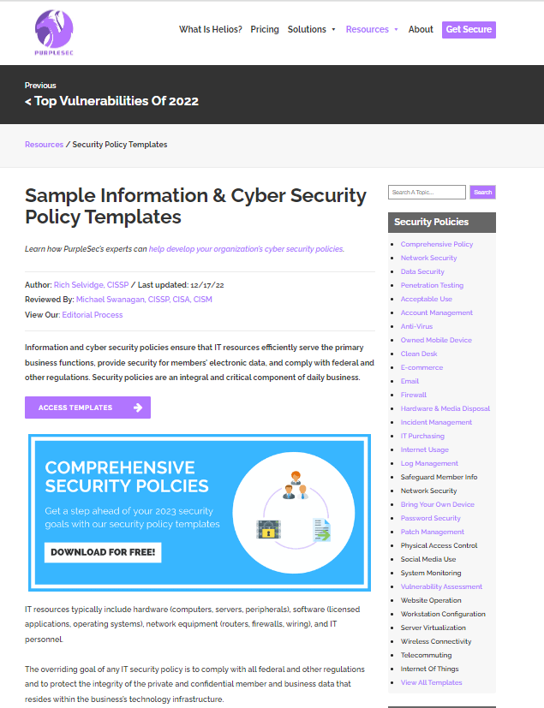
Member Driven. Patient Focused.
CSTK | Cybersecurity Templates
CS Template: Free IT & Cyber Security Policy Templates Description: This page offers a list of free Information Security Policy Templates For Small Businesses, Startups, & Enterprises by PurpleSec. Developed by: PurpleSec

Slide 24
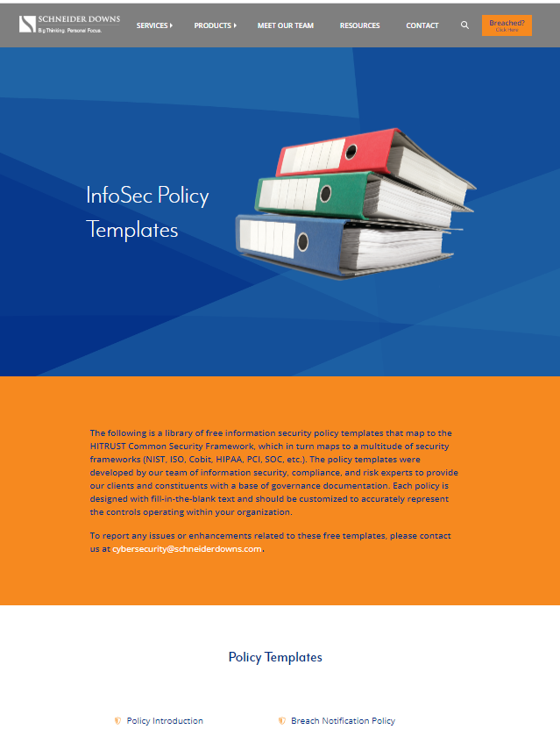
Member Driven. Patient Focused.
CSTK | Cybersecurity Templates
CS Template: InfoSec Policy Templates Description: This page contains a free library of information security policy templates that map to HITRUST Common Security Framework (which in turn maps to many other security frameworks: NIST, ISO, Cobit, HIPAA, PCI, SOC, etc.) Developed by: Schneider Downs

Slide 25
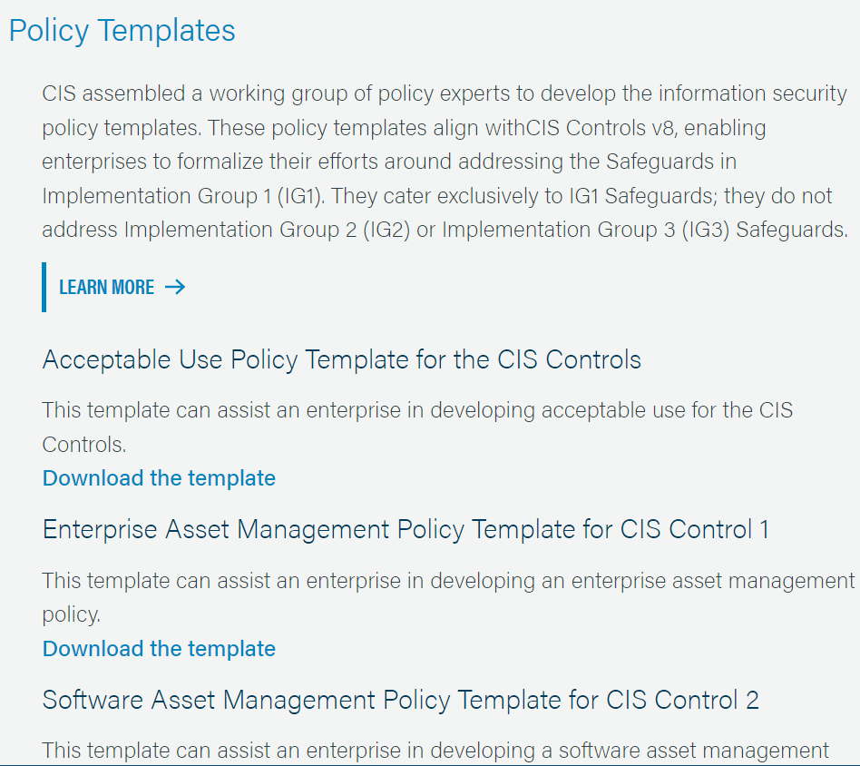
Member Driven. Patient Focused.
CSTK | Cybersecurity Templates
CS Template: Center for Internet Security (CIS) Policy Templates Description: These free policy templates by CIS align with CIS Controls v8 (see more information about this framework under the security frameworks tab). Developed by: CIS

Slide 26
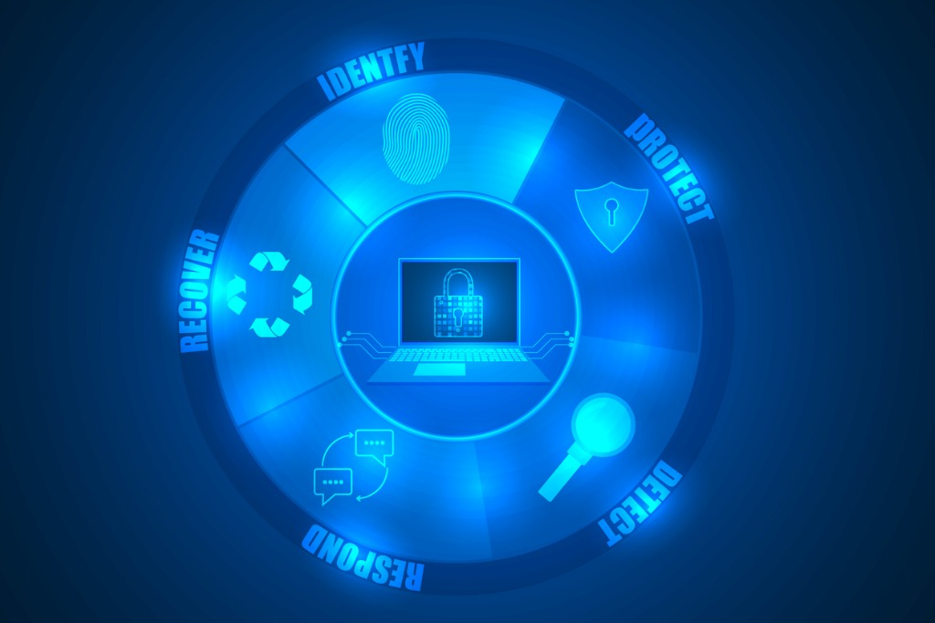
Security Frameworks
Member Driven. Patient Focused.
Table of Contents
Includes a list of security frameworks, along with brief descriptions, that could be used to maintain cybersecurity within your organization. This tab will also provide information on when this framework might be utilized.

Slide 27
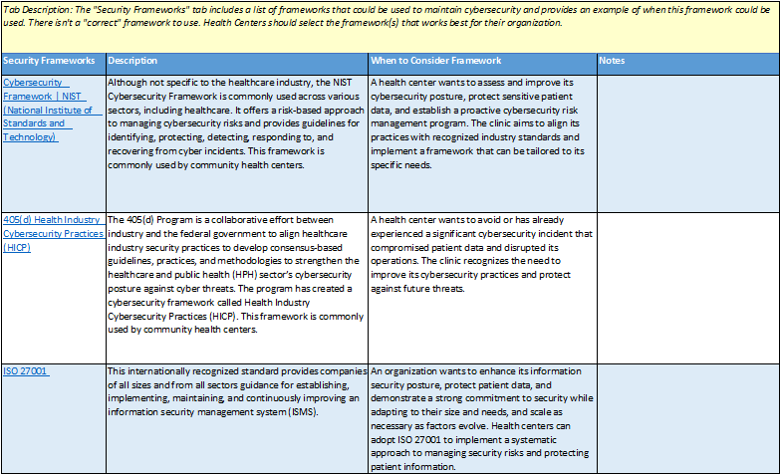
Member Driven. Patient Focused.
CSTK | Security Framework
Security Framework Description: This tab includes a list of security frameworks that provide a comprehensive and structured approach to cybersecurity, helping health organizations safeguard sensitive data, maintain operational continuity, and build trust with patients and partners.

Slide 28
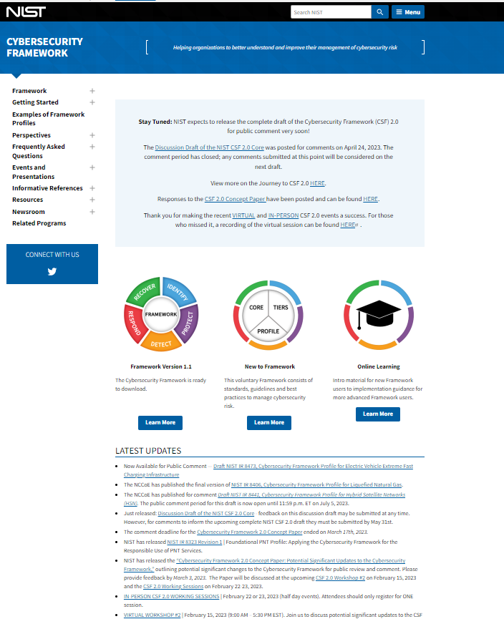
Member Driven. Patient Focused.
CSTK | Security Framework
Security Framework: Cybersecurity Framework | NIST Description: The NIST Cybersecurity Framework is commonly used across various sectors, including healthcare. It offers a risk-based approach to managing cybersecurity risks and provides guidelines for identifying, protecting, detecting, responding to, and recovering from cyber incidents. Applicable when: A health center wants to assess and improve its cybersecurity posture, protect sensitive patient data, and establish a proactive cybersecurity risk management program. This framework is commonly used by community health centers.

Slide 29
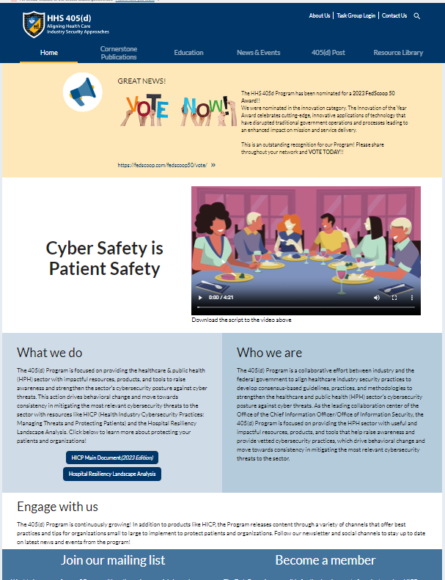
Member Driven. Patient Focused.
CSTK | Security Framework
Security Framework: 405(d) Health Industry Cybersecurity Practices (HICP) Description: The 405(d) Program is a collaborative effort between industry and the federal government to align healthcare industry security practices to develop consensus-based guidelines, practices, and methodologies to strengthen the healthcare and public health (HPH) sector’s cybersecurity posture against cyber threats. The program has created a cybersecurity framework called Health Industry Cybersecurity Practices (HICP). Applicable when: A health center wants to avoid or has already experienced a significant cybersecurity incident that compromised patient data and disrupted its operations. The clinic recognizes the need to improve its cybersecurity practices and protect against future threats. This framework is commonly used by community health centers.

Slide 30
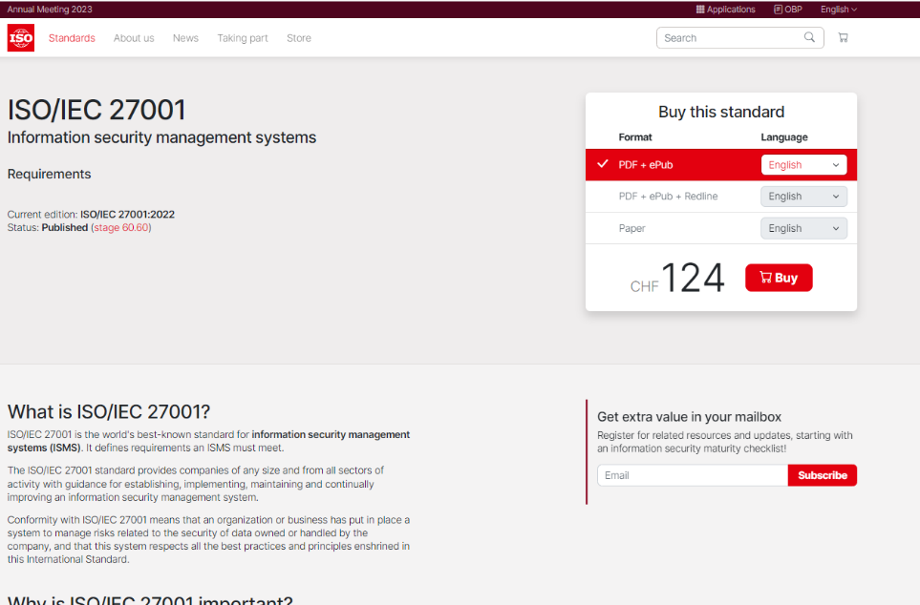
Member Driven. Patient Focused.
CSTK | Security Framework
Security Framework: ISO 27001 Description: This internationally recognized standard provides companies of all sizes and from all sectors guidance for establishing, implementing, maintaining, and continuously improving an information security management system (ISMS). Applicable when: An organization wants to enhance its information security posture, protect patient data, and demonstrate a strong commitment to security while adapting to their size and needs, and scale as necessary as factors evolve. Health centers can adopt ISO 27001 to implement a systematic approach to managing security risks and protecting patient information.

Slide 31
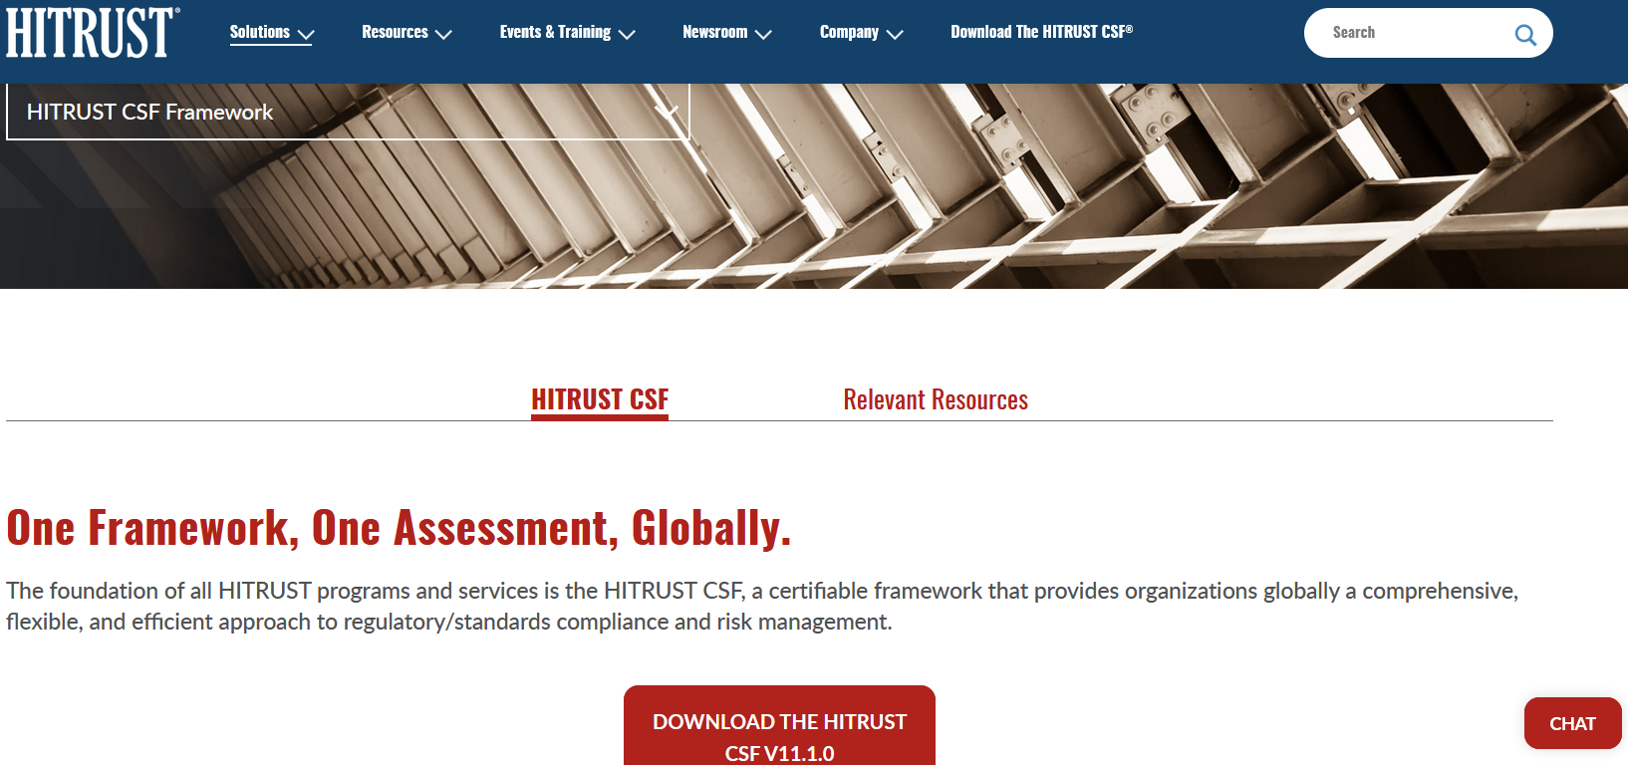
Member Driven. Patient Focused.
CSTK | Security Framework
Security Framework: HITRUST CSF (Health Information Trust Alliance Common Security Framework) Description: HITRUST CSF is a comprehensive security framework specifically designed for the healthcare industry. It is scalable and customizable, allowing organizations to tailor controls based on their specific needs. It provides a comprehensive approach to assessing and validating third-party security practices, and its certification program offers assurance to partners. Applicable when: Though most often used by developers and payers, health centers may consider using the HITRUST CSF in specific scenarios where they aim to enhance their overall cybersecurity posture, demonstrate compliance with multiple regulatory requirements, and gain a comprehensive understanding of their security and privacy controls.

Slide 32
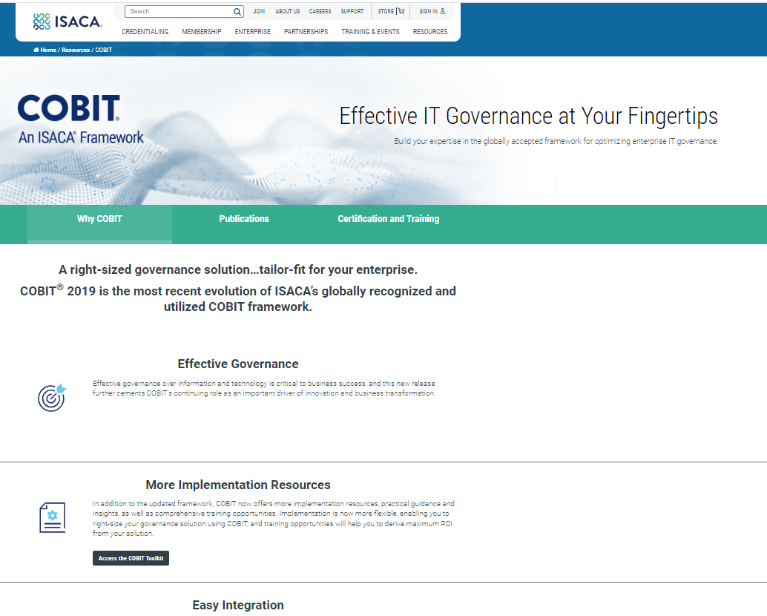
Member Driven. Patient Focused.
CSTK | Security Framework
Security Framework: COBIT (Control Objectives for Information and Related Technologies) Description: COBIT is a globally accepted framework developed by ISACA (Information Systems Audit and Control Association) for governance and management of enterprise IT. It provides a comprehensive framework to ensure effective controls, risk management, and regulatory compliance. Applicable when: A healthcare organization is implementing a new electronic health record (EHR) system across its network of hospitals or clinics. The organization wants to ensure effective governance, risk management, and compliance with regulatory requirements throughout the implementation process.

Slide 33
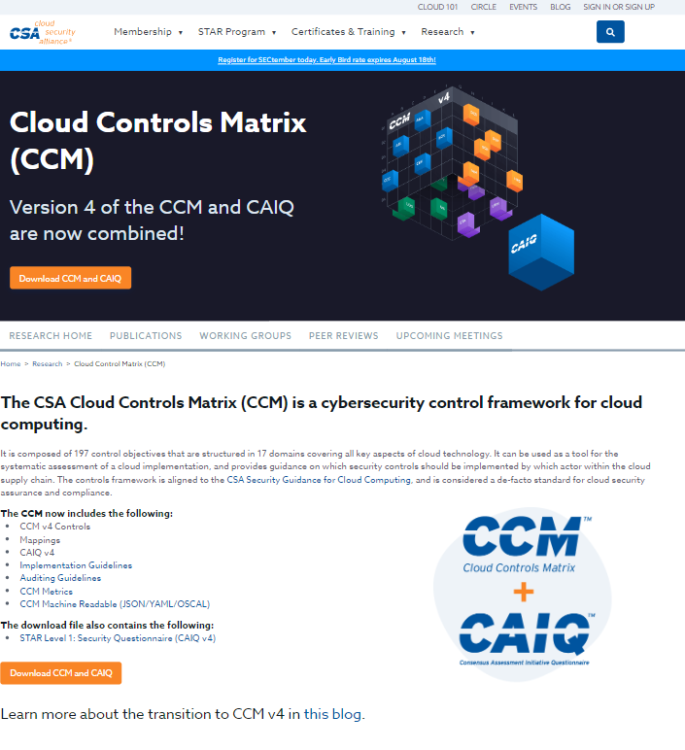
Member Driven. Patient Focused.
CSTK | Security Framework
Security Framework: CSA CCM (Cloud Security Alliance Cloud Controls Matrix) Description: If a health center uses cloud services for data storage or processing, the CSA CCM can be helpful. It offers a catalog of security best practices and controls specific to cloud computing environments, enabling clinics to evaluate and address security risks associated with cloud adoption. Applicable when: Given the organization's intention to migrate to a cloud environment, they should consider incorporating the CSA CCM. It offers cloud-specific security controls and best practices to address risks associated with cloud adoption. This framework will help the organization assess and implement appropriate security measures in their cloud environment.

Slide 34
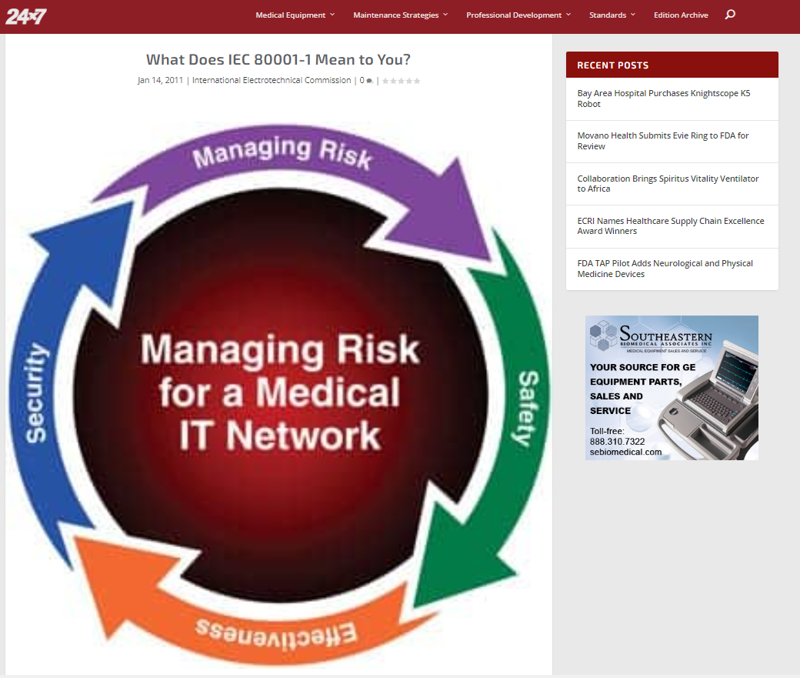
Member Driven. Patient Focused.
CSTK | Security Framework
Security Framework: IEC 80001-1 Description: This standard focuses specifically on the management of medical devices and information technology systems within the healthcare environment. It provides guidelines for managing the risks associated with the use of medical devices and their integration into the larger IT infrastructure. Applicable when: Health centers that rely on medical devices and systems interconnected with their IT networks might consider implementing the guidelines and recommendations provided by IEC 80001-1 to ensure the safe and secure use of these devices. However, there is a cost to purchase the framework guidance.

Slide 35
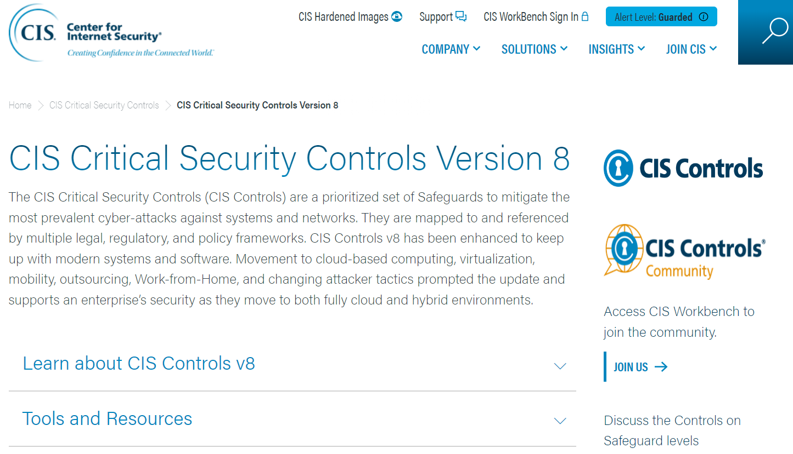
Member Driven. Patient Focused.
CSTK | Security Framework
Security Framework: CIS Controls v8 Description: A globally recognized security framework that provides a prioritized and actionable set of best practices for cybersecurity. By implementing CIS Controls, it creates an on-ramp to comply with PCI DSS, HIPAA, GDPR, and other industry regulations. CIS Controls v8 has been specifically updated to address cloud-based computing, virtualization, use of mobile devices, and remote work. Applicable when: A health center recognizes the need for a well-defined and prioritized set of controls to address the most significant risks and vulnerabilities in their environment. If an organization has already tried implementing the NIST framework and found it too difficult, the organization may find this framework easier to implement due to more specific, detailed guidance.

Slide 36

Compliance and Regulations
Member Driven. Patient Focused.
Table of Contents
Includes a list of compliance programs and regulations in healthcare that can
significantly reduce the likelihood of data breaches and strengthen overall
cybersecurity posture.

Slide 37
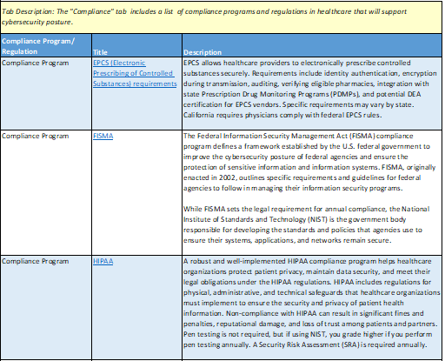
Member Driven. Patient Focused.
CSTK | Compliance/Regulations
Compliance Programs This tab lists several compliance programs along with a brief description. Compliance programs play a crucial role in establishing a proactive and robust cybersecurity posture in health organizations, safeguarding patient data, ensuring legal adherence, and mitigating the potential impact of cyber incidents.

Slide 38
Member Driven. Patient Focused.
Compliance Program | Description
EPCS (Electronic Prescribing of Controlled Substances) requirements | EPCS allows healthcare providers to electronically prescribe controlled substances securely. Requirements include identity authentication, encryption during transmission, auditing, verifying eligible pharmacies, integration with state Prescription Drug Monitoring Programs (PDMPs), and potential Drug Enforcement Administration (DEA) certification for EPCS vendors. Specific requirements may vary by state. California requires physicians comply with federal EPCS rules.
FISMA (Federal Information Security Management Act) | FISMA defines a framework established by the U.S. federal government to improve the cybersecurity posture of federal agencies and ensure the protection of sensitive information and information systems. Though FISMA outlines specific requirements and guidelines for federal agencies to follow in managing their information security programs, NIST is the government body responsible for developing the framework itself.

Slide 39
Member Driven. Patient Focused.
Compliance Program | Description
HIPAA (Health Insurance Portability and Accountability Act) | A robust and well-implemented HIPAA compliance program helps healthcare organizations protect patient privacy, maintain data security, and meet their legal obligations under the HIPAA regulations. Non-compliance with HIPAA can result in significant fines and penalties, reputational damage, and loss of trust among patients and partners. Pen testing not required, but if using NIST, you grade higher if you perform pen testing annually. A Security Risk Assessment (SRA) is required annually.
PCI DSS (Payment Card Industry Data Security Standard) | Applies to organizations that handle payment card information. Healthcare organizations processing payment card transactions need to comply with PCI DSS requirements to protect cardholder data and maintain secure payment processing systems.
SOC 2 (System and Organization Controls 2) | SOC 2 is an auditing standard developed by the American Institute of CPAs (AICPA) to that their privacy, security, and/or administrative processes are adequate to ensure the confidentiality, integrity, and availability of data. SOC 2 in healthcare is a privacy and security standard that can provide assurances to the C-Suite, to business partners, and to regulators that an organization has implemented appropriate controls to protect data (SOC 2 Type 1) and is using the controls effectively (SOC 2 Type 2).

Slide 40
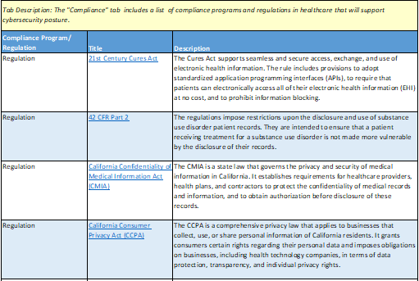
Member Driven. Patient Focused.
CSTK | Compliance/Regulations
Regulations This tab ALSO lists several regulations along with a brief description. Cybersecurity regulations are essential to create a robust and secure environment in health organizations, protecting patient data, ensuring continuity of care, and safeguarding the reputation and trust of the healthcare industry.

Slide 41
Member Driven. Patient Focused.
Regulation | Description
21st Century Cures Act | The Cures Act supports seamless and secure access, exchange, and use of electronic health information. The rule includes provisions to adopt standardized application programming interfaces (APIs), to require that patients can electronically access all of their electronic health information (EHI) at no cost, and to prohibit information blocking.
42 CFR Part 2 (Code of Federal Regulations) | The regulations impose restrictions upon the disclosure and use of substance use disorder patient records. They are intended to ensure that a patient receiving treatment for a substance use disorder is not made more vulnerable by the disclosure of their records.
California Confidentiality of Medical Information Act (CMIA) | The CMIA is a state law that governs the privacy and security of medical information in California. It establishes requirements for healthcare providers, health plans, and contractors to protect the confidentiality of medical records and information.
California Consumer Privacy Act (CCPA) | The CCPA is a comprehensive privacy law that applies to businesses that collect, use, or share personal information of California residents. It grants consumers certain rights regarding their personal data and imposes obligations on businesses, including health technology companies, in terms of data protection, transparency, and individual privacy rights.

Slide 42
Member Driven. Patient Focused.
Regulation | Description
California Medical Information Breach Notification Law | California has specific breach notification requirements for the unauthorized acquisition, access, or disclosure of medical information. Healthcare providers and other entities handling medical information must comply with these regulations and notify affected individuals and appropriate government agencies in the event of a breach.
FHIR (Fast Healthcare Interoperability Resources) | FHIR is a standard for exchanging healthcare information electronically. It promotes interoperability between different health IT systems, allowing seamless data exchange. Compliance with FHIR standards is essential for health technology companies looking to enable data sharing and interoperability.
GDPR (General Data Protection Regulation) | GDPR is a comprehensive data privacy and security law in the European Union (EU). This regulation includes steps such as mapping data, appointing a Data Protection Officer, obtaining consent, managing data subject rights, reporting data breaches, and maintaining accountability through documentation and regular audits. GDPR aims to protect individuals' personal data, maintain legal compliance, and uphold the principles of data privacy and security. GDPR covers the data of EU citizens anywhere in the world.

Slide 43
Member Driven. Patient Focused.
Regulation | Description
HTI-1 Final Rule (Health Data, Technology, and Interoperability: Certification Program Updates, Algorithm Transparency, and Information Sharing) | ONC's HTI-1 final rule implements provisions of the 21st Century Cures Act and make updates to the ONC Health IT Certification Program (Certification Program) with new and updated standards, implementation specifications, and certification criteria. Implementation of the proposed rule’s provisions will advance interoperability, improve transparency, and support the access, exchange, and use of electronic health information.
The National Cybersecurity Strategy | This strategy aims to operationalize an enduring and effective model of collaborative defense that equitably distributes risk and responsibility, and delivers a foundational level of security and resilience to America’s digital ecosystem. It also states that the U.S. will use all of its instruments of national power to disrupt and dismantle threat actors whose actions threaten its interests.

Slide 44
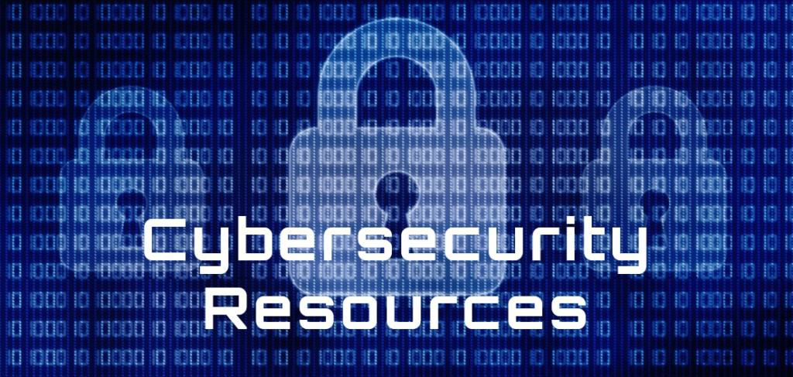
Cybersecurity Resources
Member Driven. Patient Focused.
Table of Contents
Includes relevant cybersecurity resources, along with a brief description, to help organizations improve their cybersecurity programs.

Slide 45
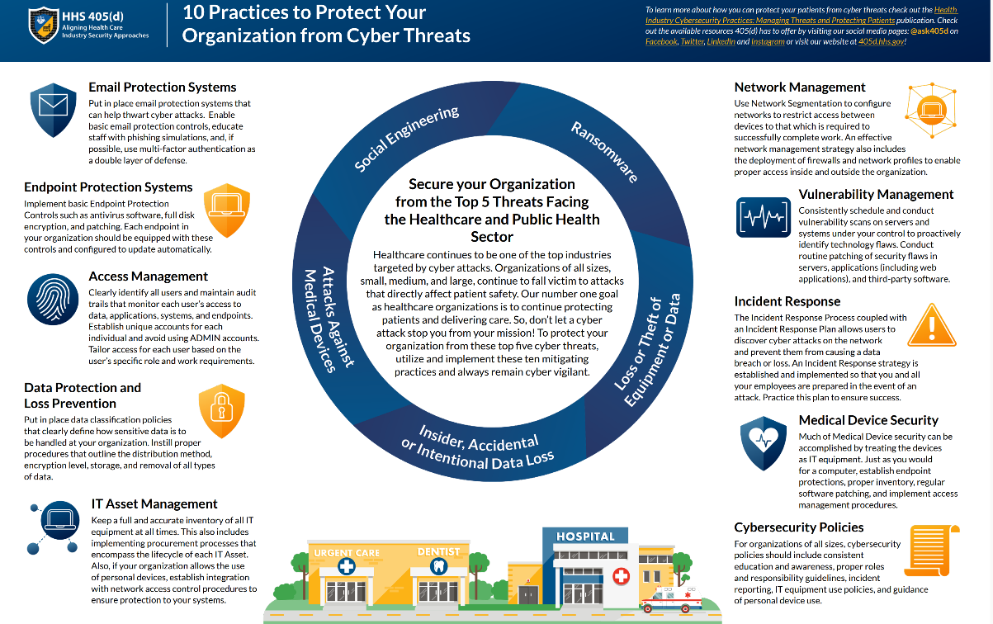
Member Driven. Patient Focused.
CSTK | Resources
Resource: 405(d) Infographics 10 Practices Description: The 405(d) Task Group identified 10 cybersecurity practices ranging from personnel training and awareness to the development and implementation of new processes, the acquisition and customization of new technology, and to fostering a consistent, robust, and continually updated approach to cybersecurity. Developed by: HHS

Slide 46
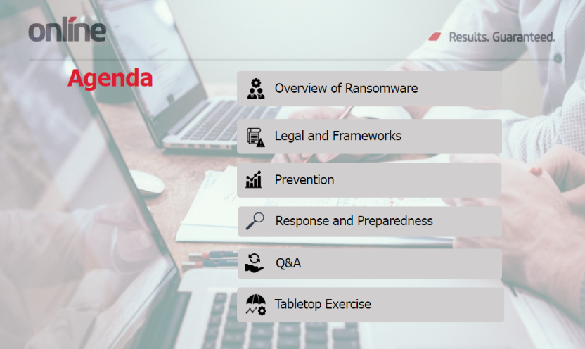
Member Driven. Patient Focused.
CSTK | Resources
Resource: CCALAC Incident Response Workshop Description: This presentation provides information on the scope and problem of ransomware. Discusses regulatory requirements and frameworks related to ransomware preparedness and response​​, provides practical steps for preventing, containing, and responding to ransomware attacks​. Developed by: Online Business Systems for CCALAC

Slide 47
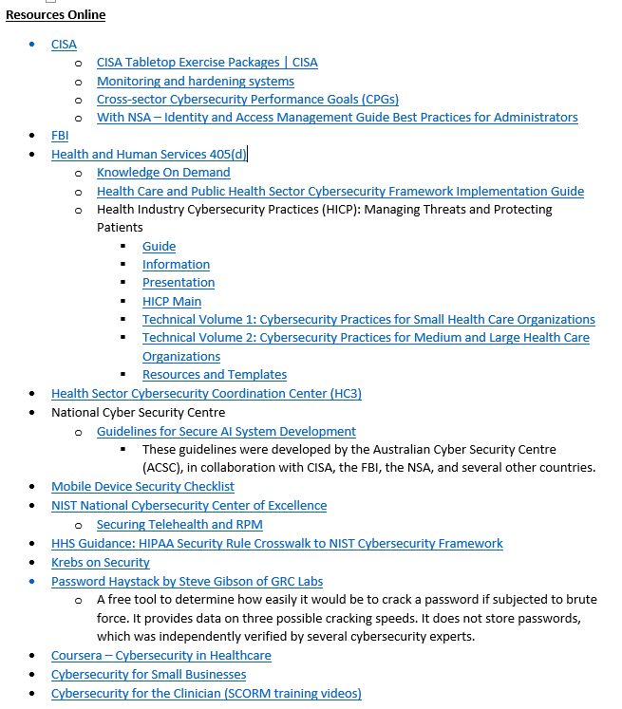
Member Driven. Patient Focused.
CSTK | Resources
Resource: CCALAC Online Cybersecurity Resources List Description: The provided list contains various cybersecurity resources available for free online. Developed by: CCALAC

Slide 48
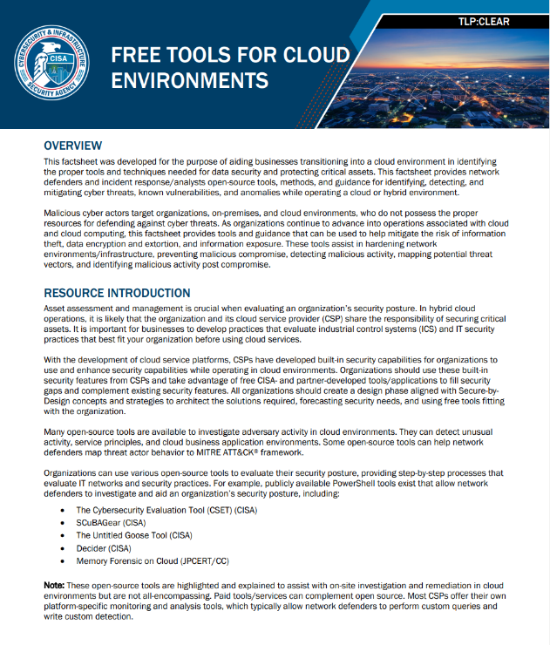
Member Driven. Patient Focused.
CSTK | Resources
Resource: CISA Free Tools for Cloud Environments Description: The document provides guidance for businesses transitioning into a cloud environment, offering open-source tools and methods to enhance data security and protect critical assets. It emphasizes the use of built-in security features from cloud service providers (CSPs) alongside free tools like CSET, SCuBAGear, Untitled Goose Tool, and Decider Tool. Developed by: CISA (Cybersecurity and Infrastructure Security Agency)

Slide 49
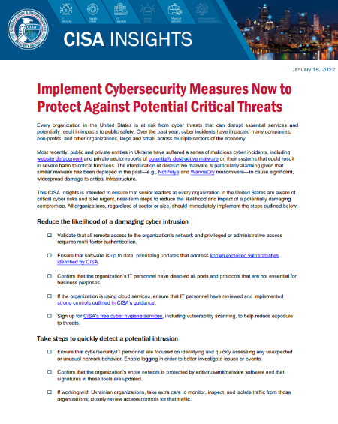
Member Driven. Patient Focused.
CSTK | Resources
Resource: CISA Insights Implement Cybersecurity Measures Description: Checklist of steps that organizations should take to reduce the likelihood of a cyber intrusion, quickly detect potential intrusions, prepare for incident response, and maximize resilience to destructive cyber incidents. Developed by: CISA

Slide 50
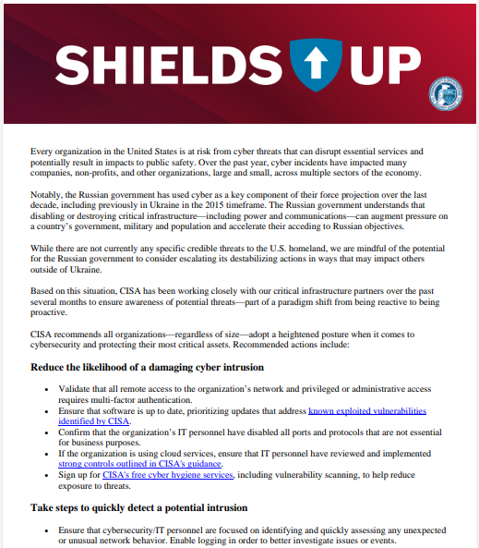
Member Driven. Patient Focused.
CSTK | Resources
Resource: CISA Steps to Minimize Cyber Impact Description: This fact sheet emphasizes how US organizations face cyber threats that can disrupt services and public safety and provides recommended actions. CISA advises organizations to enhance cybersecurity by implementing measures such as multifactor authentication, software updates, and strong controls. CISA provides assistance and urges reporting to protect others. Developed by: CISA

Slide 51
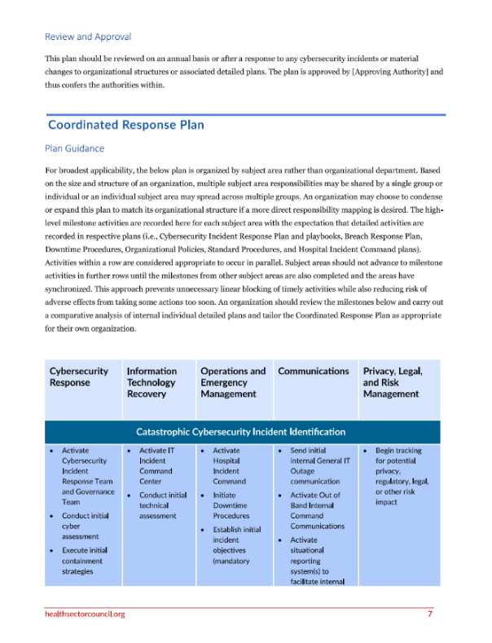
Member Driven. Patient Focused.
CSTK | Resources
Resource: Coordinated Healthcare Incident Response Plan (CHIRP) Description: This guide supplies plans and templates which provide universal guidance that can be used across industries to inform organizations about how to detect, contain, respond, and recover from a cyber security incident. Developed by: The HHS Cybersecurity Program

Slide 52
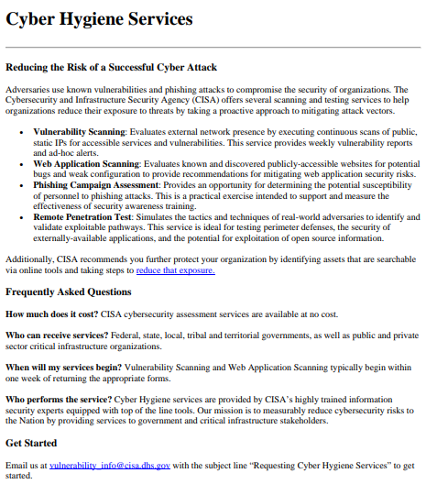
Member Driven. Patient Focused.
CSTK | Resources
Resource: Cyber Hygiene Services Description: This CISA fact sheet offers free cyber hygiene services including vulnerability scanning, web application scanning, phishing campaign assessment, and remote penetration test. Services available to federal, state, local, tribal, and territorial governments, as well as critical infrastructure organizations. Developed by: CISA

Slide 53
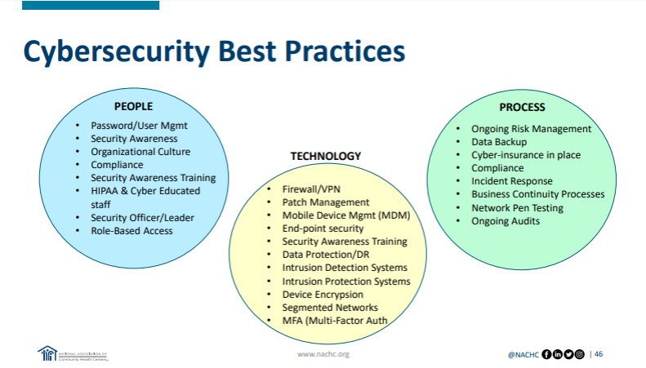

Member Driven. Patient Focused.
CSTK | Resources
Resource: Cybersecurity Considerations Pt. 1 Description: This presentation provides an introduction to data breaches, specifically who they affect. The presentation also covers how hackers find their targets and cybersecurity basic toolsets to cultivate and maintain a strong cybersecurity posture. Developed by: National Association of Community Health Centers (NACHC)

Slide 54


Member Driven. Patient Focused.
CSTK | Resources
Resource: Cybersecurity Considerations Pt. 2 Description: This presentation focuses on learning how to quantify IT security risks and how to cultivate a culture of security awareness in their organization. Includes practical exercises to know what to do WHEN not IF a data breach happens to them. Developed by: NACHC

Slide 55

Member Driven. Patient Focused.
CSTK | Resources
Resource: Cybersecurity Letter to End Users (PLEASE NOTE CLICKING ON THE LINK ABOVE WILL AUTOMATICALLY DOWNLOAD A COPY IN WORD) Description: This letter advises end users on essential cybersecurity practices to keep their computers safe. Emphasizes that the users themselves are crucial in maintaining security. Best practices include not clicking suspicious links, installing software only from trusted sources, avoiding disreputable websites, using strong passwords, etc. Encourages principle of "When in doubt, don't do it". Developed by: Jack Wallen, Tech Republic

Slide 56


Member Driven. Patient Focused.
CSTK | Resources
Resource: Effectively Benchmarking Phishing Awareness Program Description: This presentation addresses benchmarking and examines what to keep in mind when using external or internal benchmarks to assess your phishing program. Covers variables to consider while creating benchmarks and what to look for when comparing your results across industries. Developed by: SANS

Slide 57


Member Driven. Patient Focused.
CSTK | Resources
Resource: EMR in Healthcare Cybersecurity Risks Description: This presentation covers the significance, usage, benefits, and risks of Electronic Medical Records (EMR) and Electronic Health Records (EHR) in healthcare. Summary includes information on the top threats against EMR/EHR data and measures to protect it, culminating with a list of references. Developed by: The HHS Cybersecurity Program

Slide 58

Member Driven. Patient Focused.
CSTK | Resources
Resource: NIST Maturity Worksheet (PLEASE NOTE CLICKING ON THE LINK ABOVE WILL AUTOMATICALLY DOWNLOAD A COPY IN EXCEL) Description: This assessment provides a standard to describe the level to which an organization is prepared to detect, identify, and respond to cyberattacks. Developed by: Cipher

Slide 59

Member Driven. Patient Focused.
CSTK | Resources
Resource: Relias Cybersecurity Courses Description: This word document provides evaluations of different cybersecurity courses available in Relias, indicating their strengths and weaknesses. It also lists the professional CompTIA Cybersecurity Courses available. Courses curated by Relias. List created by CCALAC.

Slide 60


Member Driven. Patient Focused.
CSTK | Resources
Resource: SANS Managing Human Risk Report Description: This report provides actionable steps and resources to enable organizations to mature their awareness programs and benchmark them against others. Provides actionable steps you can take to better manage your organization’s human risk. Developed by: SANS

Slide 61

Member Driven. Patient Focused.
CSTK | Resources
Resource: Sharing Cyber Event Information Fact Sheet Description: This document helps with facilitating and encouraging cybersecurity information sharing among various organizations to improve national defense and strengthen the cybersecurity of critical infrastructure. It specifically focuses on the Cyber Incident Reporting for Critical Infrastructure Act (CIRCIA) of 2022 and the role of CISA in implementing its requirements. Developed by: CISA

Slide 62

Member Driven. Patient Focused.
CSTK | Resources
Resource: Social Engineering Red Flags Description: This infographic covers the components of social engineering red flags to look for when receiving an email. Developed by: KnowBe4

Slide 63


Member Driven. Patient Focused.
CSTK | Resources
Resource: Strengthening Cyber Posture in the Health Sector Description: This presentation provides steps to achieve strong cyber posture, such as conducting security assessments and implementing best practices. Highlights the impact of cyber incidents on the healthcare sector and need for vigilance. Emphasizes the protection of patient data and providing resources to monitor and manage risks. Developed by: Health Sector Cybersecurity Coordination Center (HC3)

Slide 64

Member Driven. Patient Focused.
CSTK | Resources
Resource: The Essential Security Checklist Description: This worksheet will help you map your personal digital assets and see where you stand in terms of cybersecurity. Answer the following questions and find useful information security tips at the bottom. Developed by: Heimdal

Slide 65

Member Driven. Patient Focused.
CSTK | Resources
Resource: What is Clinical Zero Trust? Description: This guide covers Zero Trust applied to healthcare settings and Clinical Zero Trust (CZT), which protects physical workflows instead of just devices and data. Reviews CZT’s five phases: identification, mapping, engineering, monitoring, and automation. Developed by: Medigate

Slide 66

Other Toolkits and Guides
Member Driven. Patient Focused.
Table of Contents
Includes a list of complimentary toolkits and guides that will help strengthen
an organization's cybersecurity posture.

Slide 67


Member Driven. Patient Focused.
CSTK | Resources
Resource: CEO Fraud Prevention Manual Description: This manual gives an overview of what CEO fraud is and how organizations are compromised, as well as best practices on prevention, resolution, and restitution. There are two checklists included at the end to help with response and prevention of CEO fraud. Developed by: KnowBe4

Slide 68

Member Driven. Patient Focused.
CSTK | Other Toolkits and Guides
Other Toolkit/Guide: CISA MS-ISAC Ransomware Guide * Description: This guide provides ransomware best practices and recommendations based on operational insight from CISA and MS-ISAC. The audience for this guide includes IT professionals as well as others within an organization involved in developing cyber incident response policies and procedures or coordinating cyber incident response. Developed by: CISA and MS-ISAC *Also available under cybersecurity resources at ccalac.org

Slide 69

Member Driven. Patient Focused.
CSTK | Other Toolkits and Guides
Other Toolkit/Guide: Cybersecurity Toolkit for Rural Hospitals and Clinics * Description: This guide addresses the importance of awareness, assessing organizational risks, implementing new policies and procedures, and educating staff within hospitals and clinics in order to improve data protection. Developed by: National Rural Health Resource Center *Also available under cybersecurity resources at ccalac.org

Slide 70

Member Driven. Patient Focused.
CSTK | Other Toolkits and Guides
Other Toolkit/Guide: Enterprise Guide Cybersecurity Training Description: The objective of this guide is to help staff create a cybersecurity training plan that maps to their organization’s specific needs. Developed by: ISCP (Inspiring a Safe and Secure Cyber World)

Slide 71

Member Driven. Patient Focused.
CSTK | Other Toolkits and Guides
Other Toolkit/Guide: Guide Implementing NIST Cybersecurity Framework * Description: The NIST CSF appears to be daunting at first glance. However, this white paper will demonstrate how businesses of all sizes can implement the NIST CSF with very little effort. Developed by: Netwrix *Also available under cybersecurity resources at ccalac.org

Slide 72

Member Driven. Patient Focused.
CSTK | Other Toolkits and Guides
Other Toolkit/Guide: Guide to Securing Remote Access Software * Description: Discusses the risks associated with remote access software, such as its ability to bypass security tools, evade detection, and facilitate multiple cyber intrusions. Offers a robust risk management strategy, implementing zero trust solutions, conducting user training programs, and utilizing security software for monitoring and detection. Developed by: CISA, NSA, FBI, MS-ISAC, INCD *Also available under cybersecurity resources at ccalac.org

Slide 73

Member Driven. Patient Focused.
CSTK | Other Toolkits and Guides
Other Toolkit/Guide: NIST Zero Trust Planning Guide * Description: Assists enterprise administrators, system operators and IT security officers in understanding how the various roles and tasks in the NIST Risk Management Framework (RMF) can be used when moving to a zero trust architecture. Briefly introduces zero trust, and how the RMF process can be used in a zero trust migration process. It is assumed that the reader is familiar with the concepts of zero trust as described in NIST SP 800-207 and has had exposure to federal information security practices. Developed by: NIST *Also available under cybersecurity resources at ccalac.org

Slide 74
Thank You
Member Driven. Patient Focused.
Presentation and Toolkit Developed by:
Candice Rowland, Manager of Health IT and Cybersecurity Programs and Jacky Torres, HCC Health IT Intern
Questions?
Candice Rowland
crowland@ccalac.org

