Slide 1

Overview of Transgender Health Care
Ward Carpenter, MD
Director, Transgender Health Program

Slide 2
Learning Objectives
Develop and improve Transgender sensitivity and cultural competency
Explore and understand Informed Consent Model as it applies to Transgender care
Gain understanding of the importance of hormone care for long-term health
Develop working knowledge of the provision of feminizing and masculinizing hormones including ongoing monitoring
Gain knowledge of related health concerns that stem from and impact hormone treatment

Slide 3
Disclosures
Off-label use of FDA approved medications are discussed in this presentation.
The presenter has no financial interests to disclose with the manufacturers of any of
the pharmaceuticals mentioned in this presentation.

Slide 4

Core Concept of Gender Spectrum
Notes:
So when you look at someone and categorize them as M or F, what are you really interpreting and commenting on?

Slide 5
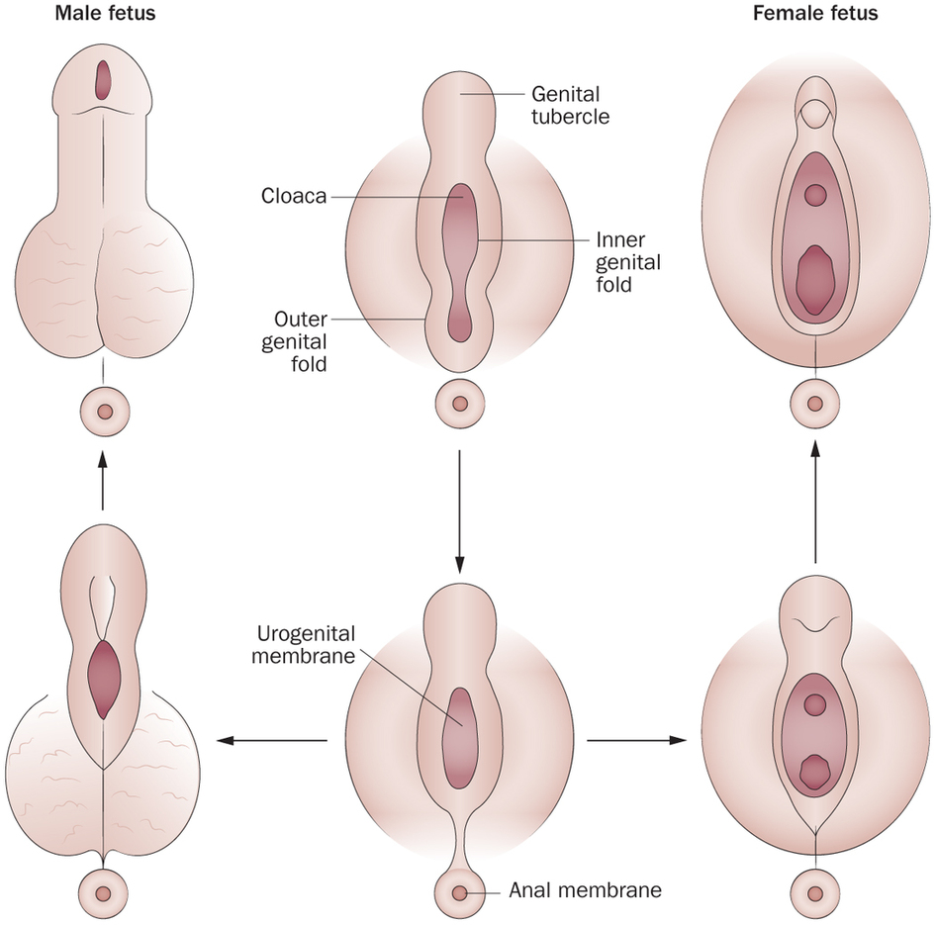
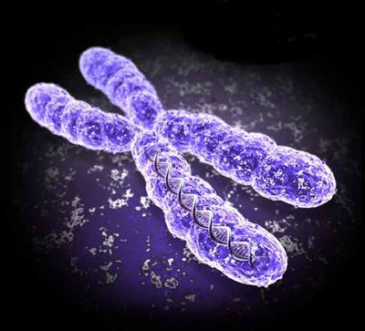
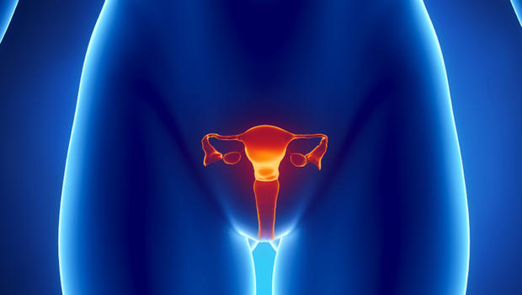
Gender vs sexuality
Sex = biological
  Chromosomal
  Hormonal
  Gonadal
  Genital
Gender Identity
Gender Expression
Gender Role
Sexual orientation
  Sexual attraction
  Romantic attraction

Slide 6
Core Concept of Gender Spectrum
  Sex: the biological concept of maleness & femaleness
  Genetic – XX, XY, etc
  Gonadal – testicles, ovaries
  Genital – penis, vagina, ambiguous
  Hormonal – testosterone, estrogen
Gender: cultural and psychological traits and behaviors associated with female, male, etc
  Gender identity: how a person feels on the inside about their gender
  Gender expression: how a person displays their gender identity to the outside world
  Gender role: social behaviors that are traditionally associated with males and females
Sexual orientation: what type of person is someone drawn to romantically and sexually
Notes:
So when you look at someone and categorize them as M or F, what are you really interpreting and commenting on?

Slide 7
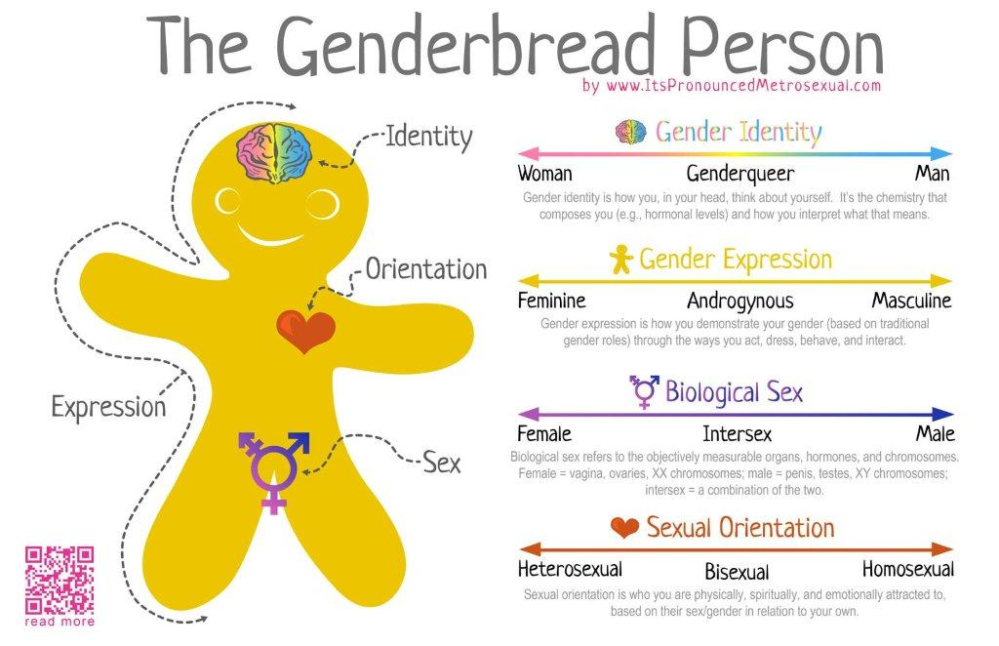

Slide 8
BARRIERS TO CARE
Trans-people postpone medical care when sick or injured due to discrimination (28%) or inability to afford (48%).
Refusal of care: 19% of trans people surveyed reported being refused care due to their transgender or gender non-conforming status, with even higher numbers among people of color in the survey.
Lack of provider knowledge: 50% of the sample reported having to teach their medical providers about transgender care
Injustice at Every Turn/ National Transgender Discrimination Survey
© Transgender Economic Empowerment Project/ TEEP, all rights reserved
Notes:
88
8
Drian

Slide 9
Foundation: Gender Dysphoria
The key reason hormone care and transitioning exists
Gender Dysphoria is a life-threatening condition
  41% of trans people reported at least one suicide attempt in their life!
Treating depression without treating gender dysphoria often does not work or helps only partially
For many trans people, the only way to help them is to “fix” their bodies

Slide 10
Coding Matters
Endocrine Disorder, NOS
Transgenderism/Transsexualism
Gender Identity Disorder
Gender Dysphoria

Slide 11
DSM-5
For a person to be diagnosed with gender dysphoria, there must be a marked difference between the individual’s expressed/experienced gender and the gender others would assign him or her, and it must continue for at least six months.
This condition causes clinically significant distress or impairment in social, occupational, or other important areas of functioning.
Gender dysphoria is manifested in a variety of ways, including strong desires to be treated as the other gender or to be rid of one’s sex characteristics, or a strong conviction that one has feelings and reactions typical of the other gender.
The DSM-5 diagnosis adds a post-transition specifier for people who are living full-time as the desired gender (with or without legal sanction of the gender change). This ensures treatment access for individuals who continue to undergo hormone therapy, related surgery, or psychotherapy or counseling to support their gender transition.
Gender dysphoria in DSM-5 is separated from Sexual Dysfunctions and Paraphilic Disorders.

Slide 12

“Feminizing/masculinizing hormone therapy - the administration of exogenous endocrine agents to induce feminizing or masculinizing changes – is a medically necessary intervention for many transsexual, transgender, and gender nonconforming individuals with gender dysphoria”
WPATH Standards of Care V. 7(p. 33)

Slide 13
Hormones & Improved Quality of Life
Newfield et al (2006) among 446 FTM
  those on hormones had statistically significant higher quality of life than those not on hormone therapy.
Gorin-Lazard et al (2012)
  hormone therapy significantly associated with higher quality of life, after adjusting for confounding factors (cross-sectional).
Murad et al (2009) systematic review & meta-analysis
  “sex reassignment” (hormones + surgery) likely improves gender dysphoria, psychological functioning and comorbidities, sexual function and overall quality of life.

Slide 14

Results
Prospective study of 325 consecutive adults undergoing hormone and surgical transition
  Statistically significant improvements in gender dysphoria scores
  Psychological function improved among all patients
  Fewer than 2% expressed regret
  (Smith, Van Goozen, Culper et al 2005)

Slide 15



What’s your model?
Gate-keeper vs informed consent

Slide 16
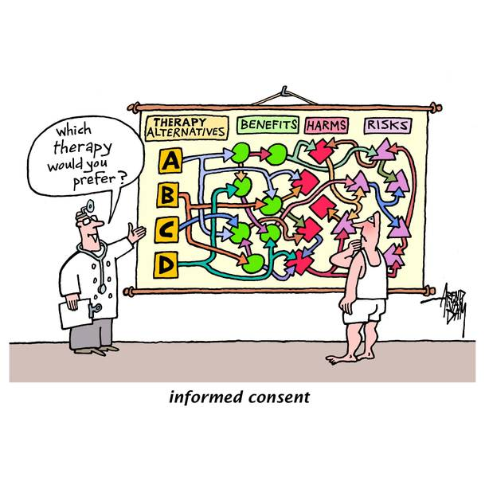
Core Concept:
Informed Consent

Slide 17

Adult Decision Making
Tattoos
Marriage
Plastic surgery
Childbearing
Home purchases
Barely require proof of age & signature

Slide 18
Informed Consent
Informed consent is the process by which the treating health care provider discloses appropriate information to a competent patient so that the patient may make a voluntary choice to accept or refuse treatment
It originates from the legal and ethical right the patient has to direct what happens to their body and from the ethical duty of the physician to involve the patient in their health care

Slide 19
Informed Consent Elements
The nature of the decision/procedure
Reasonable alternatives to the proposed intervention
The relevant risks, benefits, and uncertainties related to each alternative
Assessment of patient understanding
The acceptance of the intervention by the patient
Documentation of what you discuss in a standardized way

Slide 20

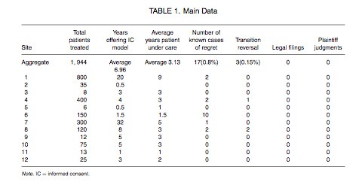

Slide 21
Prescribing Hormones is Relatively Simple
Have you ever prescribed testosterone for hypogonadism?
Have you ever prescribed spironolactone for PCOS?
Have you ever prescribed estrogen replacement therapy for a post-menopausal woman?
Yes?…then you can provide transgender hormone care

Slide 22
Prescription and Monitoring
Begin at low-medium starting dose
Monitor with labs and follow-up
Adjust doses as indicated by patient experience and physical/lab findings
Monitor with labs and follow-up
*Hormone level testing??

Slide 23
Important Resources for PCPs
Center of Excellence for Transgender Health Primary Care Protocol
WPATH Standards of Care Version 7
Clear Messages:
Hormone care can be performed by trained primary care providers
You have the tools to do it!

Slide 24

Psychosocial Concerns
Assess how transition will affect and be affected by:
Housing
Employment
Finances
Family support
Relationship
Safety

Slide 25





Creating A Welcoming Office Environment
LGBTQIA-welcoming materials displayed in the office go a long way to establishing a safe space
© Transgender Economic Empowerment Project/ TEEP, all rights reserved

Slide 26
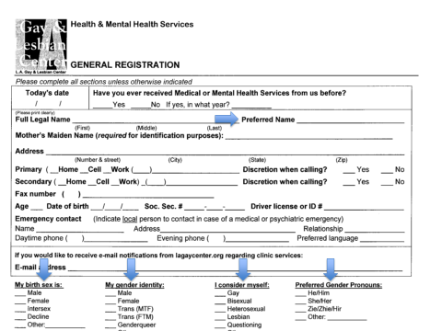

Slide 27
Initial Evaluation
Establish persistent gender dysphoria
Establish ability to provide informed consent
Evaluate and optimize* underlying medical and mental health conditions
  *Optimization can almost always be done concurrently with treatment
Evaluate and optimize internal and external supports

Slide 28

Conditions with Direct Impact on Hormone Treatment
Smoking
Hypercoagulable state – SLE, malignancy, hereditary, recent trauma
Unstable/active CV disease
Active or history of breast, prostate, endometrial or ovarian cancer
Severe unstable mental illness
Pregnancy

Slide 29

Conditions with Indirect Impact on Hormone Treatment
    Alcohol and drugs
    Obesity
    Diabetes
    Chronic kidney disease
    Stable CV disease
    Mild-moderate mental illness
    Sexual exposures
    Other cancers
    Other well-controlled chronic illnesses
    Family History of Direct Impact conditions

Slide 30
Initial Patient Education
Discuss likely physical and mental benefits of hormones
Discuss health and mental health risks
Discuss permanent and reversible changes
Discuss fertility
Discuss patient’s own goals for their transition and help them set realistic expectations
Discuss specific forms of hormones and assist patient in choosing best form for them

Slide 31
Effect | Expected Onset of Effect | Expected Maximum Effect | Reversible or Permanent if Estrogen stopped
Breast growth | 3-6 months | 2-3 years | Permanent
Thinning/slowed growth of body and facial hair | 6-12 months | >3 years | Reversible
Softening of skin/decreased oiliness | 3-6 months | unknown | Reversible
Body fat redistribution to more feminine pattern | 3-6 months | 2-5 years | Reversible
Decreased muscle mass/strength | 3-6 months | 1-2 years | Reversible
Decreased libido (sex drive) | 1-3 months | 1-2 years | Reversible
Decreased spontaneous/morning erections | 1-3 months | 3-6 months | Reversible
Male sexual dysfunction (eg erections not as firm) | variable | variable | Reversible
Decreased sperm production/maturation, reduced fertility | variable | variable | Possibly permanent
Decreased testicular volume by 25-50% | 3-6 months | 2-3 years | Likely permanent
Cessation of male pattern balding | No regrowth, loss stops 1-3 months | 1-2 years | Reversible
(Hembree et al 2009, Dahl et al 2006, Coleman et al 2012)

Slide 32
Effect | Expected Onset | Expected Maximum Effect | Reversible or Permanent Effect if Testosterone Stopped
Facial/body hair growth | 1-6 months | 1-2 years | Permanent
Increased muscle mass/strength (significantly dependent on amount of exercise) | 6-12 months | 2-5 years | Reversible
Deepened voice | 3-12 months | 1-2 years | Permanent
Cessation of menstrual periods | 2-6 months | n/a | Reversible
Clitoral enlargement (by 1-3 centimeters) | 3-6 months | 1-2 years | Permanent
Body fat redistribution to a more masculine pattern (decreased on buttocks/hips/thighs, increased in abdomen) | 3-6 months | 2-5 years | Reversible
Skin oiliness/acne (may be severe) | 1-6 months | 1-2 years | Reversible
Male pattern baldness (hair loss at temples and crown of head, highly dependent on age and inheritance) | >12 months | variable | Permanent
Increased libido (sex drive) | variable | variable | Reversible
(Hembree et al 2009, Dahl et al 2006, Coleman et al 2012)

Slide 33
Initial Evaluation (cont)
Physical exam +/- genital exam
Labs
  CBC
  CMP
  Lipids
  Urinalysis
  +/- Prolactin
  If able: HIV, STI screen, Thyroid testing

Slide 34

Feminizing Hormone Therapy

Slide 35
Feminizing Hormones
Goal is to reduce or eliminate typically masculine characteristics while creating or enhancing typically feminine characteristics
Anti-androgens reduce the effect of endogenous male sex hormones and push the body towards the feminine “default”
Estrogen induces/enhances the development of female secondary sexual characteristics (using lowest possible dose)

Slide 36
Hormone Choices
Anti-androgen – backbone
  Spironolactone is vast majority in US
  May also use finasteride or dutasteride. Safe but much less effective
Estrogens
  Topical/transdermal
  Oral/sublingual
  Injectable
Progesterone – most controversial
  Injectable
  Oral

Slide 37
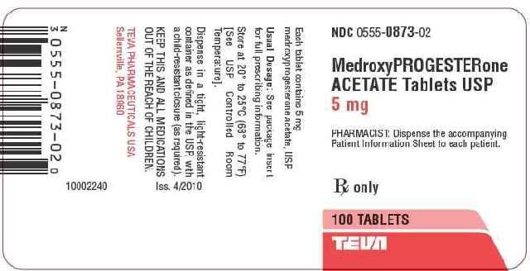
Not 1st line: Micronized Progesterone
Used for mood swings, hot flashes, insomnia, low libido, low energy which can come from suppressed testosterone state/estrogen
  Prometrium 100mcg PO qhs is bioidentical and therefore preferred
  Medroxyprogesterone has more CV risk, non-preferred. This was used in Women’s Health Study
  May also cause slight increased breast size, likely water retention > true breast tissue growth
  Undocumented anecdotal changes to areola
(Dahl et al 2006, Meyer 1986, UCSF 2011)

Slide 38
Feminizing Hormone Notes
Avoid ethinyl estradiol and premarin – incr thrombogenicity
Estradiol is safest and cheapest; transdermal is least thrombogenic
After first 3 years, consider switch to maintenance regimen

Slide 39
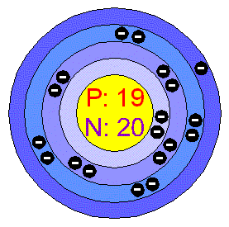
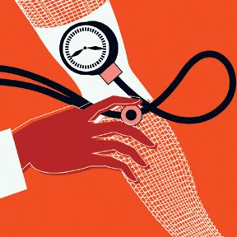
Monitoring Visits
Within the first year, every two-three months follow-up.
After the first year, patients can be seen every 6-12 months.
Monitoring Parameters: Blood Pressure, Weight.
Labs:
As little as: FBG, annual fasting lipids, serum potassium, renal function yearly.
As much as: CBC, CMP, prolactin, fasting blood glucose (1x/year), testosterone, estradiol
STI screen and HIV testing depending on risk behavior.
(Feldman JL & Goldberg J 2008, Hembree et al 2009, UCSF 2011, Coleman et al 2012, Dahl et al 2006)

Slide 40
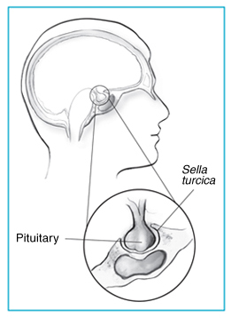
Prolactin levels
If no change after 1 year, development
of prolactinoma is rare
Worry if level is over 100. Consider decreasing dose instead of stopping cold turkey, and monitoring
MRI with and without contrast to evaluate

Slide 41
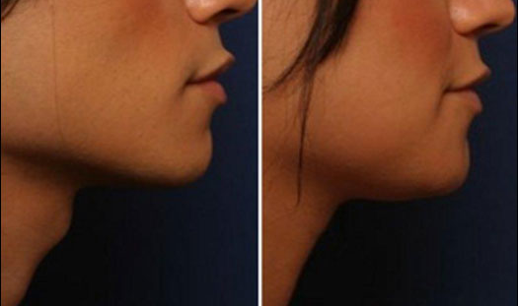
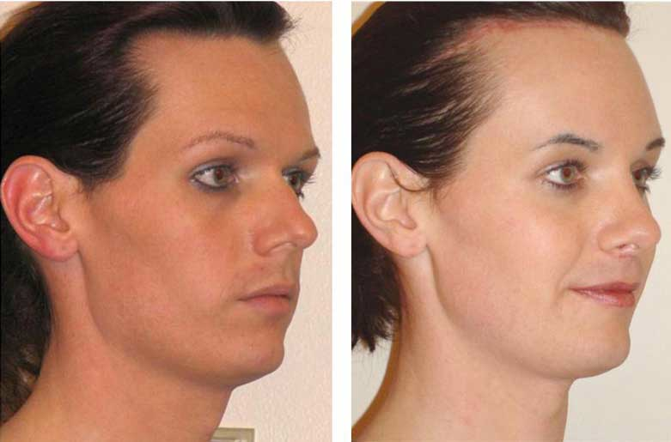
Common Surgeries
Breast Augmentation
Facial Feminization Surgeries (FFS)
Chondrolaryngoplasty or Tracheal Shave
Orchiectomy
Vulvoplasty, Vaginoplasty, Labiaplasty
Implants of silicone or saline in buttocks, hips, thighs, etc.

Slide 42


Silicone
Only silicone implants and micro-injections of silicone (by a plastic surgeon or dermatologist) are safe.
“Street” silicone can be mixed with mineral oils and various unknown substances.
Complications: inflammation (can be chronic, SEVERE, lifelong), edema, migration of silicone including to the lungs (possible PEs).
Breasts, buttocks, chests, hips, and face are most common places for injection.
Prevention education is CRITICAL!!
(Feldman 2008; Styperek et al 2013)

Slide 43
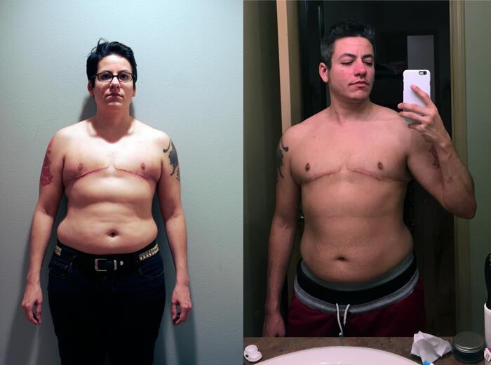
Masculinizing Hormone Therapy

Slide 44
Testosterone therapy: Goals
Primary endpoint is cessation of ovarian cycling, i.e. menstrual bleeding, cramping, bloating
Masculinization of body shape, voice, hair pattern
Push towards more masculine way of thinking and interacting with the world
(Feldman JL & Goldberg J 2008, Hembree et al 2009, UCSF 2011, Coleman et al 2012, Dahl et al 2006)

Slide 45
Hormone choices
Injectable
  Weekly provides more stability
  SQ injections are proven equivalent; most patients prefer
  Ability to fine-tune dose
Topical
  Avoids injections
  Very stable levels
  Risk of transfer to household/intimate contacts

Slide 46
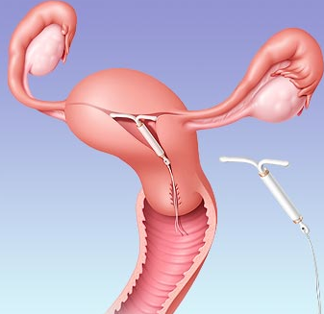
Contraception & Pregnancy
Testosterone is not a reliable form of contraception! Ovulation does not necessarily cease with menses
Testosterone is teratogenic – crosses placenta and can cause virilization and unknown defects to fetus
Contraceptive counseling: condom/barrier method, IUD (non-hormonal), depo provera
(Steinle 2011, Feldman JL & Goldberg J 2008, Gorton et al 2005, Dahl et 2006)

Slide 47
Aromatization of
Testosterone -> Estrogen
The most challenging part of managing testosterone therapy
Most of the circulating estrogen in cis-males is derived from the extraglandular conversion of testosterone and androstenedione to E2 and E1, respectively
Liver, skin, fat, muscle, bone, and kidney all contain an aromatase enzyme
Often means we must decrease rather than increase testosterone to achieve the desired effects

Slide 48
Too much?
Or not enough?
Signs of elevated estrogen include typical menstrual symptoms – cramping, spotting, dysphoria
  Checking testosterone and estrogen levels may be useful but often not necessary with good history
Causes: testo dose too high or too low, obesity (adipose tissue produces estrogen), too infrequent dosing of testosterone (change to weekly dosing), missed doses, “bad batch”
Be sure to consider other reasons for these symptoms as well, including cancer, endometriosis, polyps

Slide 49
Monitoring Visits
1-3 months after initiation of testosterone
  Assess changes via history and physical exam (especially menses cessation), check BP and weight
  Labs include Hgb/Hct, lipids, CMP +/- testosterone (free)
  Assess mood impacts, relationship impacts
At 6 months and then every 6-12 months depending on clinical scenario
  Ensure continued amenorrhea
  Labs: fasting lipid panel, CMP, Hgb +/- testosterone
  Assess mood, relationships, weight & BP regularly
(Feldman JL & Goldberg J 2008, Hembree et al 2009, UCSF 2011, Coleman et al 2012, Dahl et al 2006)

Slide 50
Endometrium/Ovaries –
What should we worry about?
Lack of progesterone, anovulation, aromatization to estrogen, plus insulin resistance – ????
NO evidence that this is leading to endometrial hyperplasia in FTMs
  Atrophic effect of androgen on endometrium is described (Perrone et al 2009, Mueller et al 2007, and Zang et al 2007)
  Grynberg et al (2009) histology study revealed changes in ovarian architecture, similar to PCOS. No ovarian cancers. Concluded uterine histology is not very different from non-hyperandrogenic women.
Most in-vivo and in-vitro data show absence of stimulating effect on endometrial proliferation & no evidence of increased ovarian cancer associated with testosterone (although there are case reports – see Hage et al 2007)
Hysterectomy/oophorectomy as prevention no longer recommended

Slide 51
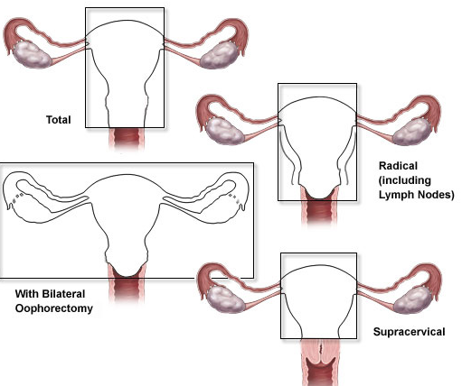
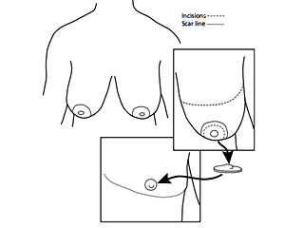
Most Common Surgeries
Breast removal
--double-incision
--keyhole
Hysterectomy (TAH BSO, enquire about cervical removal)
Metoidoplasty or Phalloplasty
Less common:
Body sculpting

Slide 52
Learning Objectives
Develop and improve Transgender sensitivity and cultural competency
Explore and understand Informed Consent Model as it applies to Transgender care
Gain understanding of the importance of hormone care for long-term health
Develop working knowledge of the provision of feminizing and masculinizing hormones including ongoing monitoring
Gain knowledge of related health concerns that stem from and impact hormone treatment

Slide 53
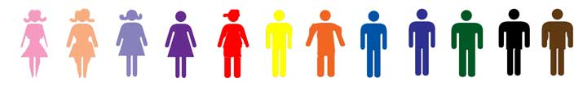
Remember
Gender is on a spectrum and varies from person to person
Trans patients will often come in with a long history of mistreatment by the healthcare system
Treating Gender Dysphoria is a medically necessary intervention that is easy to do and literally saves lives
Providing a safe space for trans* people to be themselves is the most important thing you can do

